Slide 1
Perceived Touristic Attractiveness in the Porto Metropolitan Area Based on Google Places Reviews
Authors: Beatriz Santos, Bruno Rocha, Joana Guerreiro

Slide 2
🎯Main Objective
To build a Global Index of Perceived Touristic Attractiveness (IGPTA) using user ratings and reviews.
To explore spatial patterns of perceived attractiveness in the Porto Metropolitan Area.

Slide 3
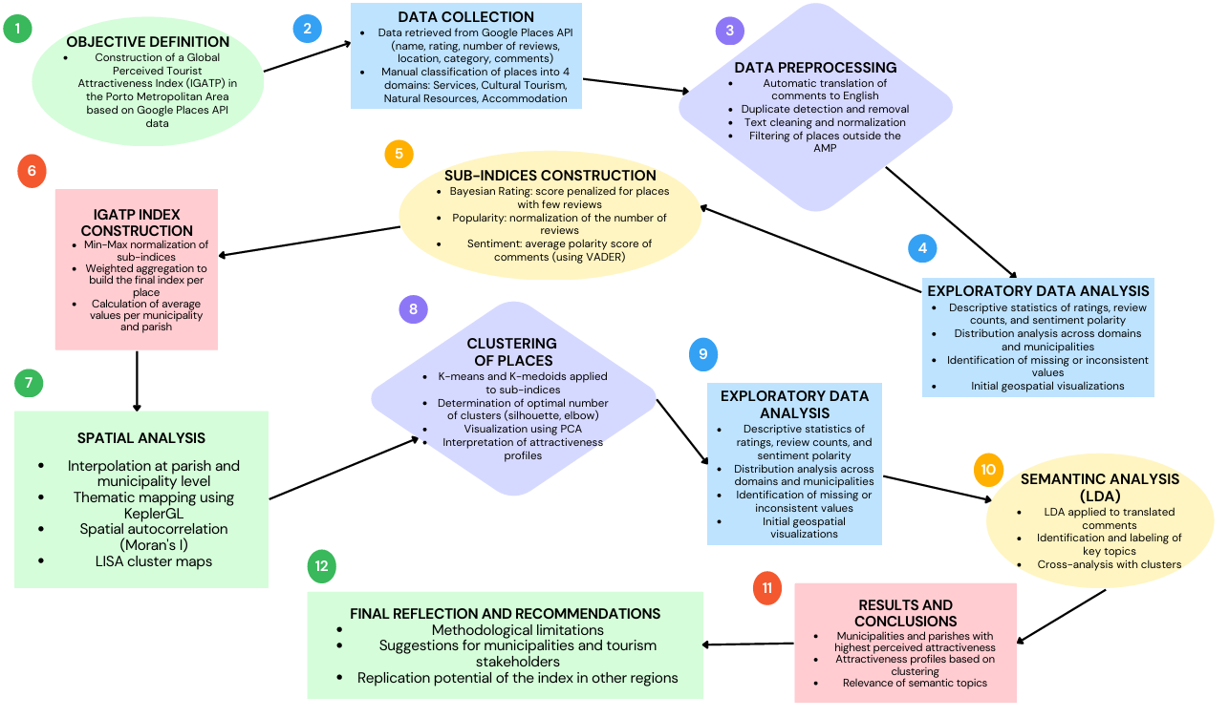
Flowchart

Slide 4
What is Touristic Attractiveness?
🧭 Definition (project-specific): "Touristic attractiveness refers to the degree to which a location captures visitors’ interest and preference, based on online perception, shared experiences, and qualitative evaluation."
💬 Note:
The index focuses on perceived attractiveness, not actual tourist flows.

Slide 5
Data Overview
📌 Source: Google Places API
📍 Study Area: 17 municipalities in the Porto Metropolitan Area (AMP)
📂 Datasets:
google_places_AMP_with_coordinates.csv: place information + average rating
comments_google_maps_AMP.csv: up to 5 reviews per place

Slide 6
Data Overview
How Google selects the 5 reviews shown via the Places API:
Although we did not find official documentation from Google explicitly detailing how the 5 reviews returned by the Places API are selected, we believe that the selection is likely based on internal criteria such as overall relevance (i.e., how useful the review is to other users), engagement (e.g., number of likes), the reviewer’s profile (such as being an active Local Guide), recency (with newer reviews more likely to appear), and language preferences (according to the request’s language or regional settings). In our view, Google seems to aim for a representative sample of opinions, rather than showing only the most positive or the most negative reviews.

Slide 7
Data Overview
📊 Variable Dictionary – Ratings (google_places_AMP_with_coordinates.csv)
📊 Variable Dictionary – Comments (comments_google_maps_AMP.csv)
Variable | Description
City | Municipality where the point of interest is located
Category | Category assigned to the place (restaurant, museum, hotel, bar, tourist attraction, cafe, church, park, natural feature, viewpoint, trail, lodging)
Name | Name of the establishment or point of interest
Rating | Average rating given by users for the place
Address | Full address of the place
Types | List of categories assigned by the Google API
Latitude | Geographic latitude coordinate of the place
Longitude | Geographic longitude coordinate of the place
Total Reviews | Total number of reviews received by the place
Variable | Description
City | Municipality where the point of interest is located
Category | Category assigned to the place (e.g., restaurant, hotel, park)
Place Name | Name of the establishment or point of interest
Author | Name of the user who wrote the comment
Text | Original text of the comment published by the user
Date | Relative date of the comment (e.g., 'a year ago')
Rating | Rating assigned in the comment (1 to 5 stars)

Slide 8
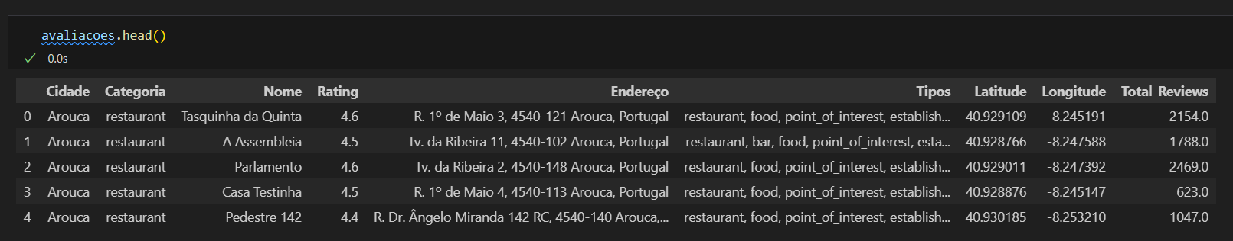
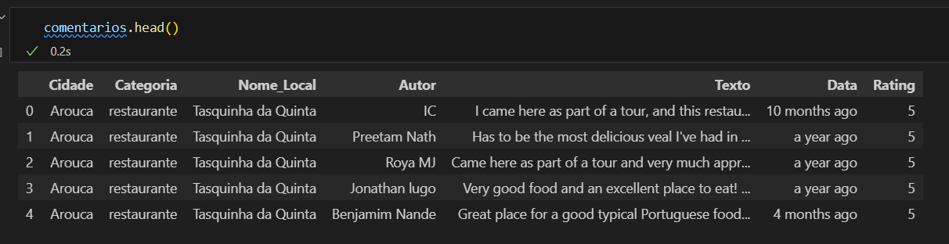
Database Structure
Ratings (google_places_AMP_with_coordinates.csv)
Comments (comments_google_maps_AMP.csv)

Slide 9
Pre Processing - Ratings (google_places_AMP_with_coordinates.csv)
Delete rows where rating value is null
Replace null values ​​with 0 in the “Total_Reviews” column
Grouped places by thematic category (each place was classified into one of four categories): Services, Cultural Tourism, Natural Resources, or Lodging
based on its Google Places types (Services: restaurants, cafés, bars | Cultural Tourism: museums, attractions, churches | Natural Resources: parks, viewpoints, trails | Lodging: hotels, informal lodging)
💡 This categorization is used for map filters and exploratory analysis, not for the composite index.

Slide 10
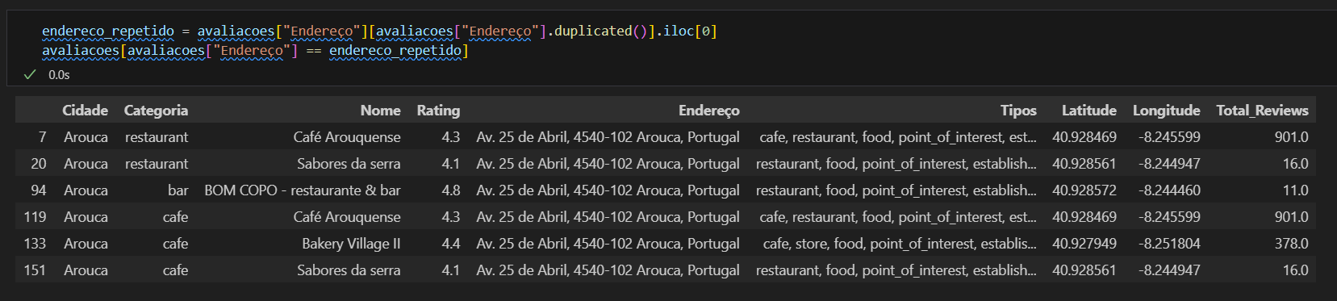
Pre Processing - Ratings (google_places_AMP_with_coordinates.csv)
A unique identifier was created for each combination of place name and address, in order to ensure the distinction between truly different establishments and to avoid double-counting the same location.

Slide 11
Pre Processing - Ratings (google_places_AMP_with_coordinates.csv)
New variable: Nearby_Similar_Places
↪ Counts places of the same category within 100 meters (using geodesic distance)
However, due to the structure of the dataset—where the same location may be assigned to multiple categories (e.g., restaurant, café, bar)—multiple entries may exist for a single place. To avoid duplication and ensure a representative measure of thematic competition, the variable was aggregated using the maximum value recorded per place (ID). This decision aims to capture the most competitive context a location may face. For example, if a place is classified simultaneously as a restaurant and a bar, and there are 5 restaurants but only 1 bar nearby, the variable should reflect the value 5, acknowledging that the location exists in a highly competitive thematic environment, rather than smoothing it to an average of 3.
This variable is used to contextualize popularity — distinguishing between places that are popular despite nearby alternatives and those that benefit from being the only option. It was not included in the Global Tourist Attractiveness Index because it does not directly measure the attractiveness of a location itself, but rather its surrounding competitive environment. This variable enriches the exploratory analysis and interactive visualizations by helping to identify clustering patterns and contextualize tourist behavior, and is also displayed in the popup when a user clicks on a point of interest.

Slide 12
Data Overview
📊 Variable Dictionary – Ratings (ratings_clean.csv)
Variable | Description
City | Municipality where the point of interest is located
Category | Category assigned to the place (restaurant, museum, hotel, bar, tourist attraction, cafe, church, park, natural feature, viewpoint, trail, lodging)
Name | Name of the establishment or point of interest
Rating | Average rating given by users for the place
Address | Full address of the place
Types | List of categories assigned by the Google API
Latitude | Geographic latitude coordinate of the place
Longitude | Geographic longitude coordinate of the place
Total Reviews | Total number of reviews received by the place
Thematic Group | Thematic group in which the place was classified (e.g., services, cultural tourism)
Similar Places Nearby | Number of places in the same category within 100 meters radius
Is Positive | Binary variable based on polarity (1 if positive, 0 otherwise)

Slide 13
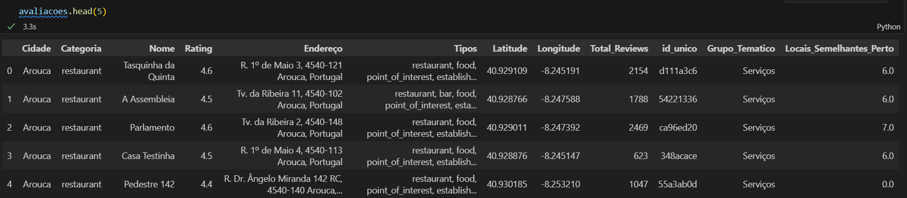
Database Structure
Ratings (ratings_clean.csv)

Slide 14
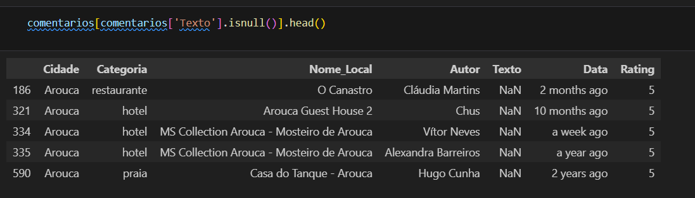
Pre Processing - Comments (comments_google_maps_AMP.csv)
Removal of missing comments.
Whitespace at the beginning and end of each comment was removed (strip), and the comment column was converted to string format to ensure consistency.
Conversion of relative dates – The original Date column in the comments contained relative expressions (e.g., “4 months ago”, “a year ago”). To enable accurate chronological analysis, the dateparser library was used to interpret these expressions and convert them into absolute dates (Data_Convertida), based on the system’s current date.
for the average polarity monthly trend chart

Slide 15
NLP - Comments
💬 Text processing steps:
Language detection and translation: Each comment's language was detected using the langdetect library (with exception handling via LangDetectException). If the comment was not originally in English, it was translated using GoogleTranslator from the deep_translator library. The final English version was stored in a new column named translated_text.
Text normalization: Lowercasing, removal of punctuation and extra whitespace. A customized stopword removal was applied — keeping semantically relevant terms like "not" while discarding only function words (articles, prepositions, etc.).
Tokenization and lemmatization: The spaCy library was used to tokenize and reduce words to their canonical form (lemmas), improving the consistency of semantic analysis.
Sentiment analysis (TextBlob and VADER): Both sentiment tools were applied to each cleaned comment. The resulting polarity score (scale -1 to 1) was stored, and the average polarity per place was computed to support the attractiveness index.
to then apply topic modeling
to perform one of the sub indexes

Slide 16
Data Overview
📊 Variable Dictionary – Comments (comments_clean.csv)
Variable | Description
City | Municipality where the point of interest is located
Category | Category assigned to the place (e.g., restaurant, hotel, park)
Place Name | Name of the establishment or point of interest
Author | Name of the user who wrote the comment
Text | Original text of the comment published by the user
Date | Relative date of the comment (e.g., 'a year ago')
Rating | Rating assigned in the comment (1 to 5 stars)
Language | Original language of the comment
Translated Text | Comment translated into English (if applicable)
Normalized Text | Normalized version of the comment (lowercase, no punctuation/accents)
Lemmatized Text | Lemmatized version of the comment (base forms of words)
Polarity | Sentiment polarity score of the comment (continuous value from -1 to 1)

Slide 17
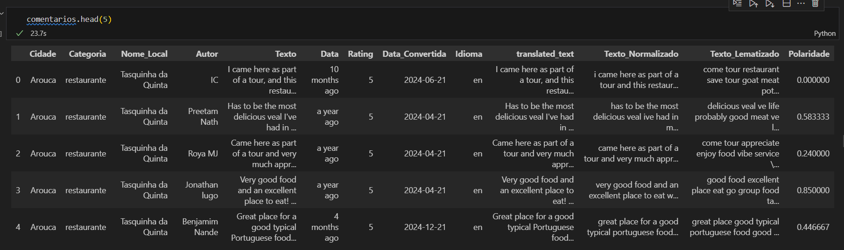
Database Structure
Comments (comments_clean.csv)

Slide 18
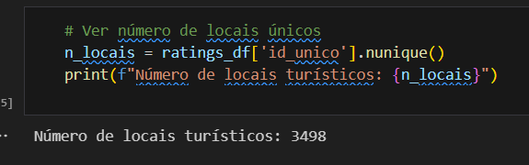
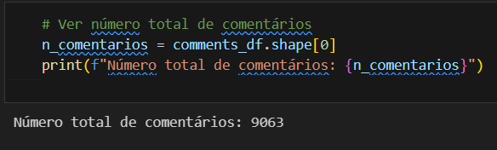
Descriptive Exploratory Analysis
Number of tourist locations: 3498
Total number of comments collected: 9063

Slide 19
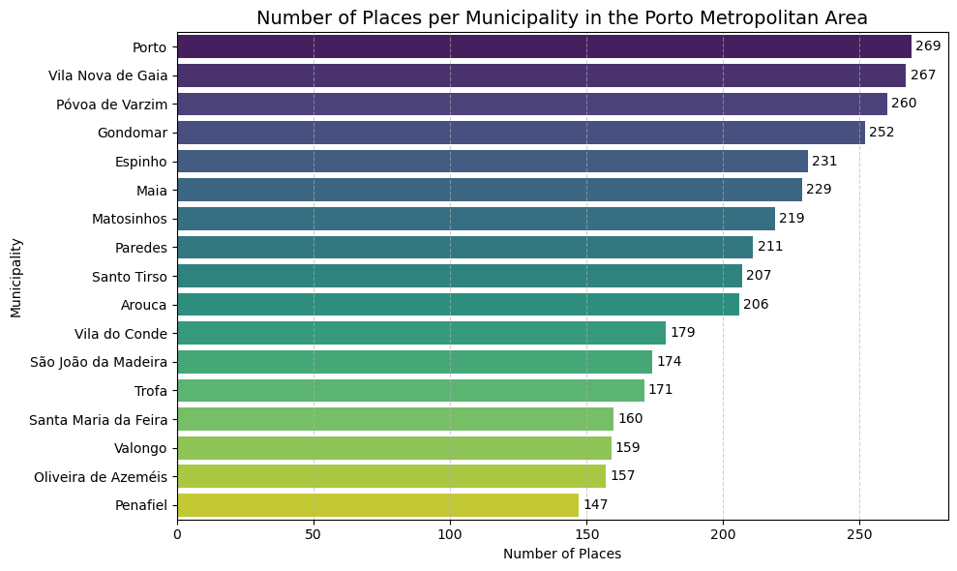
Descriptive Exploratory Analysis
Locations by Municipality:
The distribution of tourist sites across the Porto Metropolitan Area shows a notably higher concentration in the larger urban centres—Porto (269 sites) and Vila Nova de Gaia (267)—followed by Póvoa de Varzim (260), Gondomar (252) and Espinho (231). This pattern reflects not only population density and economic dynamism but also the digital visibility of these attractions on review platforms. Nonetheless, the gap between the municipality with the most sites (Porto) and the one with the fewest (Penafiel, with 147) remains relatively moderate, indicating a balanced territorial coverage well-suited for comparative analysis of perceived tourist attractiveness.

Slide 20
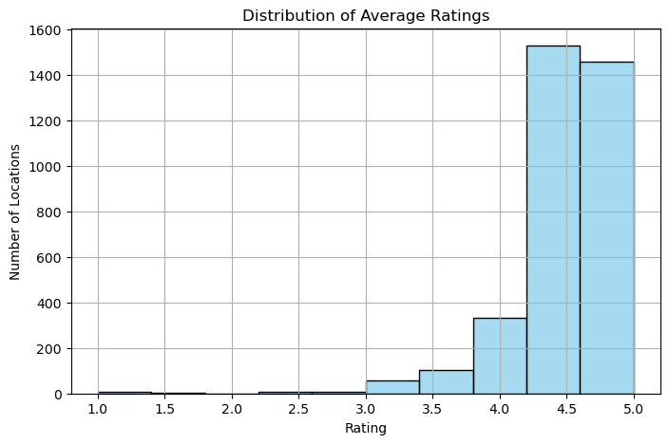
Descriptive Exploratory Analysis
Descriptive Statistics for “Rating”:
The Ratings exhibit a strongly positive overall perception of the assessed sites, with a mean of 4.46 on a 1–5 scale. The median is 4.5, and 75% of locations have ratings of 4.3 or higher, indicating a pronounced skew toward favorable evaluations. Nonetheless, there is some variability (standard deviation = 0.40), and the minimum value of 1.0 confirms the presence of a small number of negative experiences.

Slide 21
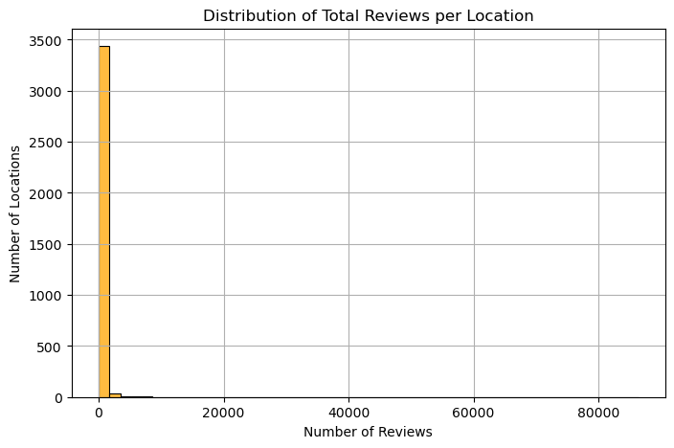
Descriptive Exploratory Analysis
Descriptive Statistics for “Total_Reviews”:
The Total_Reviews variable is highly skewed: among 3,498 sites, the median is 0 (half of all POIs have received no reviews, and this remains true up to the 75th percentile), whereas the mean (≈166) and standard deviation (≈1,780) are driven upward by a handful of extremely popular locations. Indeed, the maximum value of 86,331 reviews underlines a long right tail, where few sites concentrate the vast majority of feedback. Consequently, when constructing the Popularity sub‐index, it is advisable to apply an appropriate transformation (e.g., logarithm) or robust normalization technique to mitigate the influence of these outliers and enable fairer comparisons across all locations.

Slide 22
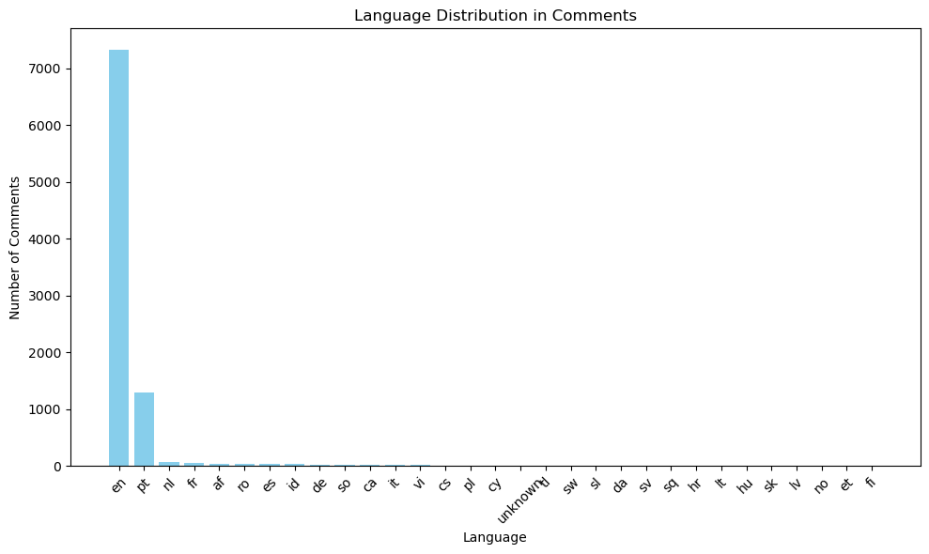
Descriptive Exploratory Analysis
Language Distribution in Comments
The analysis of comment languages (9,000 total) shows a strong dominance of English (≈7,332 entries), followed by Portuguese (≈1,298). The remaining languages form a “long tail”: Dutch (68), French (53), Afrikaans (40), Romanian (39), Spanish (35) and Indonesian (33) together account for only a few hundred comments, while German, Somali, Catalan, Italian and others appear even less frequently (5–20 occurrences). Dozens of additional languages (e.g., Vietnamese, Czech, Polish, Galician, Latvian) are represented sporadically, and five comments could not be identified. This pattern justifies our choice to auto-translate all comments into English and apply sentiment tools optimized for that language, while highlighting the need for broader multilingual approaches in future work to fully capture the corpus’s linguistic diversity.

Slide 23
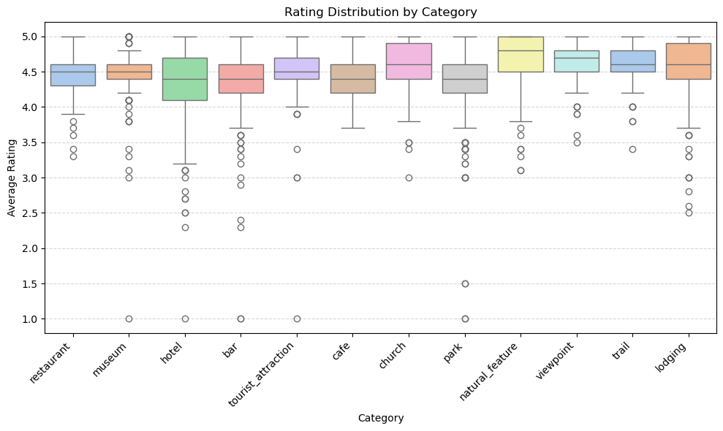
Descriptive Exploratory Analysis
Rating Distribution by Category
The category-wise rating distributions exhibit distinct patterns in both central tendency and variability. “Natural_feature,” “viewpoint,” and “church” show medians around 4.8–5.0★ with narrow interquartile ranges, indicating uniformly high and consistent ratings. In contrast, “hotel,” “bar,” and “park” have lower medians (approximately 4.2–4.4★) and wider boxes, reflecting more diverse visitor experiences; these categories also include a noticeable number of low-end outliers (1.0–2.0★). “Cafe” and “tourist_attraction” share similar medians (≈4.4–4.5★) with moderate spread, while “restaurant” and “museum” occupy intermediate positions, featuring medians near 4.5★ and relatively compact distributions. Overall, natural sites and viewpoints enjoy the strongest consensus of positive ratings, whereas accommodations, bars, and parks display more polarized feedback.

Slide 24
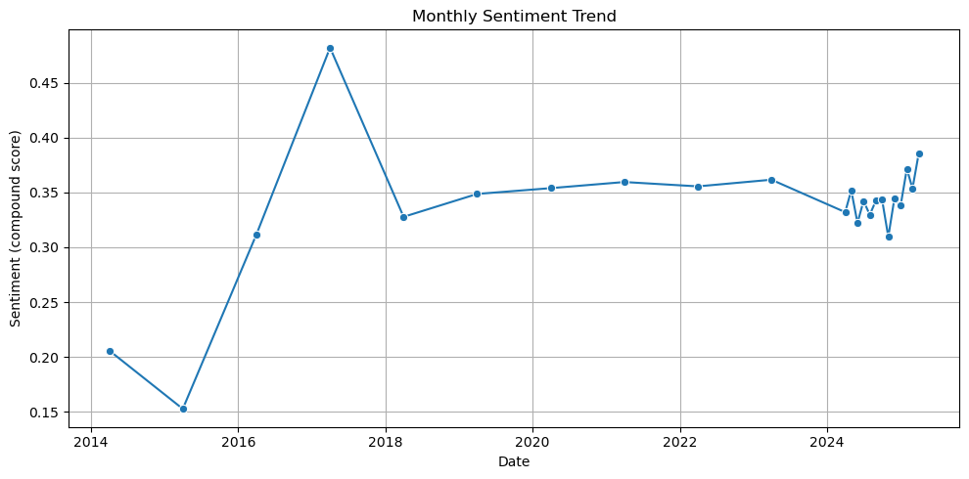
Descriptive Exploratory Analysis
Monthly Trend of Average Polarity
The monthly average polarity trend chart displays several notable peaks and troughs—most prominently a sharp rise between 2017 and 2018—which may reflect specific events (such as attraction renovations, promotional campaigns, or seasonal factors). From 2019 through mid-2024, polarity stabilizes around 0.33–0.36, with a modest uptick toward the end of 2024 and early 2025, indicating a slight increase in positivity in the most recent comments. Although based on up to five reviews per location and relative-date conversions, this longitudinal pattern underscores a generally consistent positive perception over time, warranting future validation with more comprehensive historical data.

Slide 25
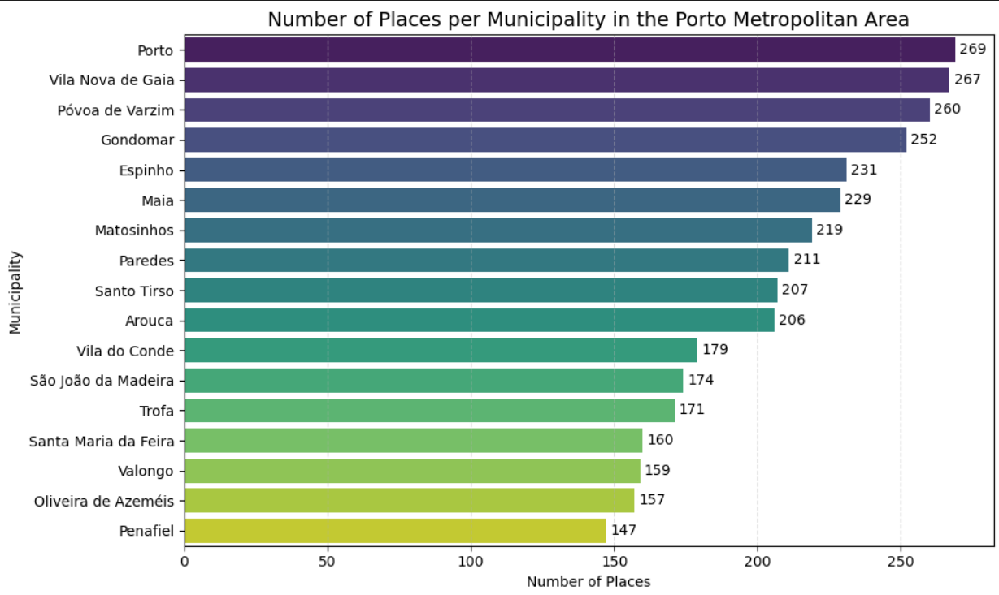
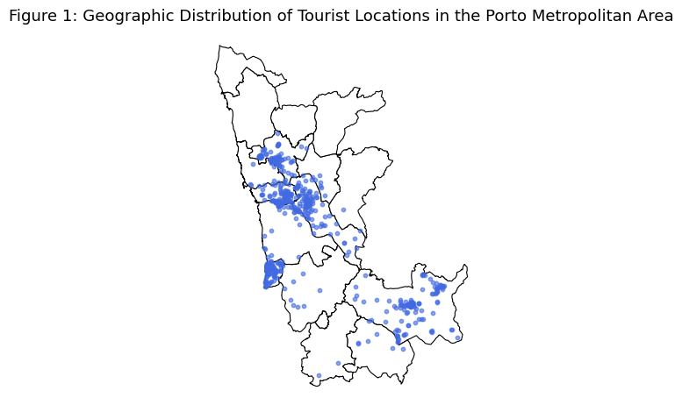
Spatial Exploratory Analysis
However, when we plot the spatial distribution using the geographic coordinates, there are several gaps in coverage, indicating that the coordinates obtained from the Google Places API are not fully reliable.
Based on the CSV data:

Slide 26
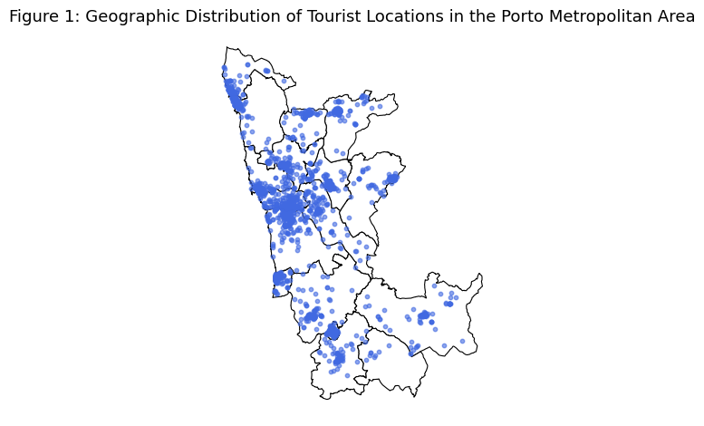
Spatial Exploratory Analysis
Given that we had the address column, we attempted geocoding to retrieve missing coordinates. The result improved overall coverage, although some gaps remain due to addresses that could not be resolved via geocoding.
The outcome was as follows:

Slide 27
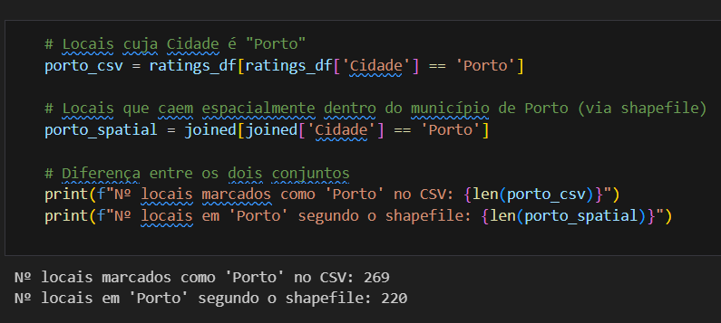
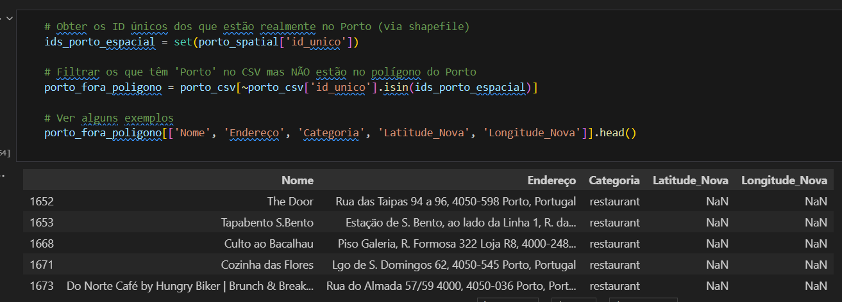
Spatial Exploratory Analysis
Nonetheless, even after geocoding some locations still lack coordinates, but this gap has been substantially reduced.

Slide 28
Spatial Exploratory Analysis
The geographic distribution of points of interest shows a strong concentration in the urban core of the Porto Metropolitan Area, particularly along the coastal corridor encompassing Porto, Vila Nova de Gaia, and Matosinhos. Secondary clusters appear in Póvoa de Varzim and Vila do Conde, as well as more scattered groups in inland municipalities such as Penafiel and Santa Maria da Feira. Despite gaps in coordinates for some records—which may underrepresent the most central areas—it is evident that perceived attractiveness is not confined to a single hub: there are both densely reviewed historic centers and coastal tourism poles, along with occasional clusters in peripheral municipalities. This pattern suggests a complementarity between established urban areas and natural or cultural destinations in the surrounding region.

Slide 29
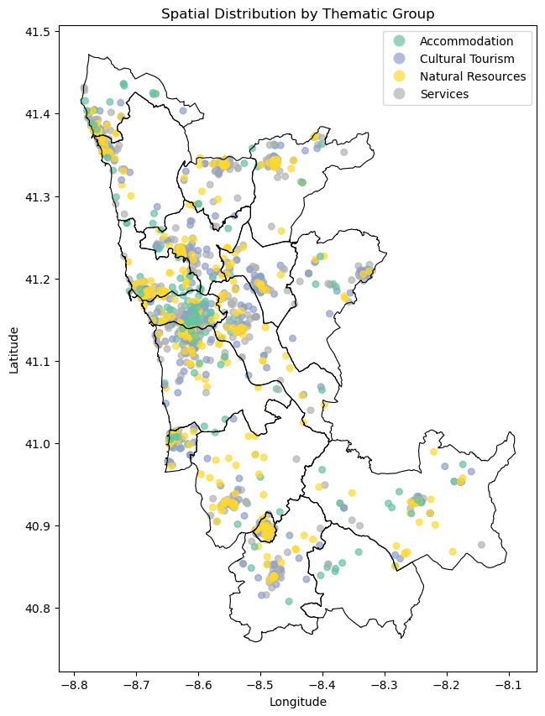
Spatial Analysis
Spatial Distribution of Tourist Locations by Thematic Group
This map displays the spatial distribution of tourist-related locations in the Porto Metropolitan Area (AMP), classified by thematic group.
Thematic categories shown:
🟢 Accommodation: hotels, hostels, guesthouses.
🟡 Cultural Tourism: museums, historical sites, churches.
🔵 Natural Resources: parks, viewpoints, nature trails.
⚪ Services: cafés, restaurants, bars.
A higher concentration of diverse locations is observed in urban centers such as Porto, Vila Nova de Gaia, and Matosinhos.
In more peripheral municipalities, natural and cultural points of interest tend to dominate the landscape.
This spatial breakdown confirms the territorial reach and thematic diversity of the data, serving as a baseline for further spatial or cluster-based analysis.

Slide 30
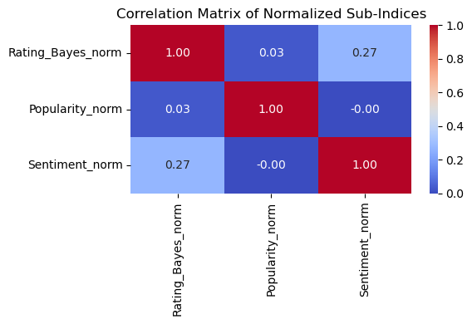
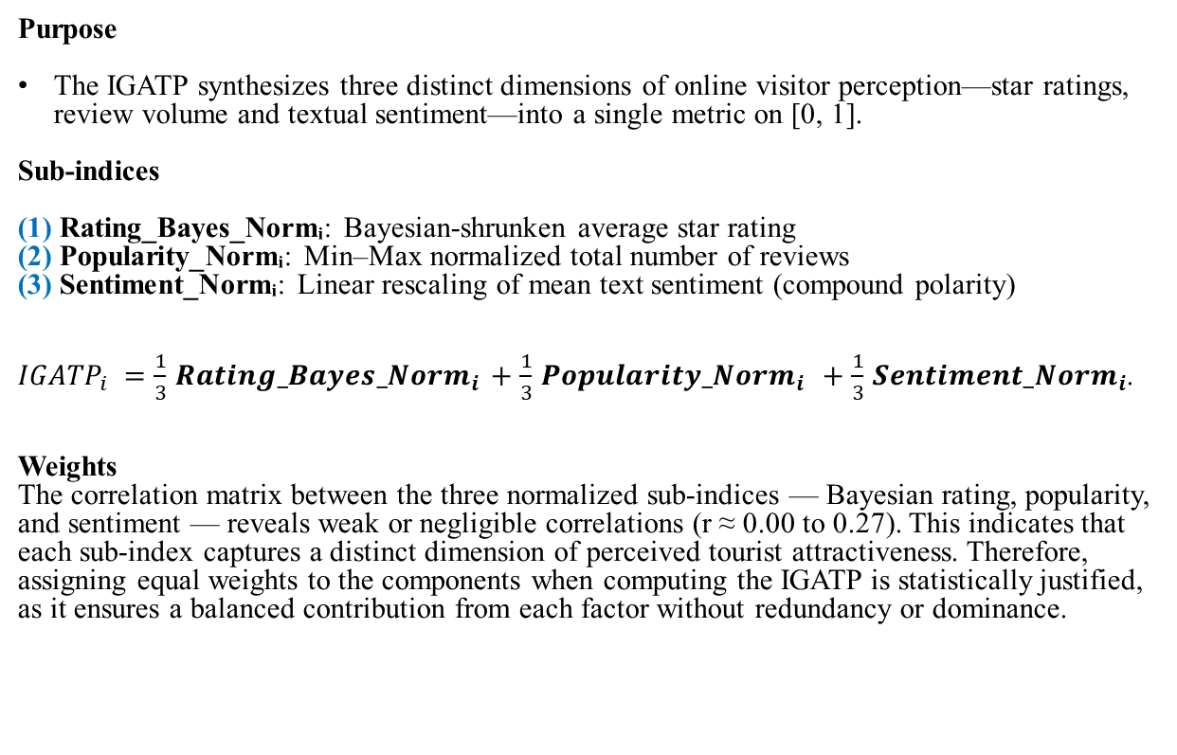
Global Index of Perceived Tourist Attractiveness
Purpose
The IGATP synthesizes three distinct dimensions of online visitor perception—star ratings, review volume and textual sentiment—into a single metric on [0, 1].
Sub-indices
(1) Rating_Bayes_Normᵢ: Bayesian-shrunken average star rating
(2) Popularity_Normᵢ: Min–Max normalized total number of reviews
(3) Sentiment_Normᵢ: Linear rescaling of mean text sentiment (compound polarity)
$IGATP_{i}=\frac{1}{3}Ratin{g_Bayes_Norm}_{i}+\frac{1}{3}{Popularity_Norm}_{i} +\frac{1}{3}{Sentiment_Norm}_{i}$.
Weights
The correlation matrix between the three normalized sub-indices — Bayesian rating, popularity, and sentiment — reveals weak or negligible correlations (r ≈ 0.00 to 0.27). This indicates that each sub-index captures a distinct dimension of perceived tourist attractiveness. Therefore, assigning equal weights to the components when computing the IGATP is statistically justified, as it ensures a balanced contribution from each factor without redundancy or dominance.

Slide 31
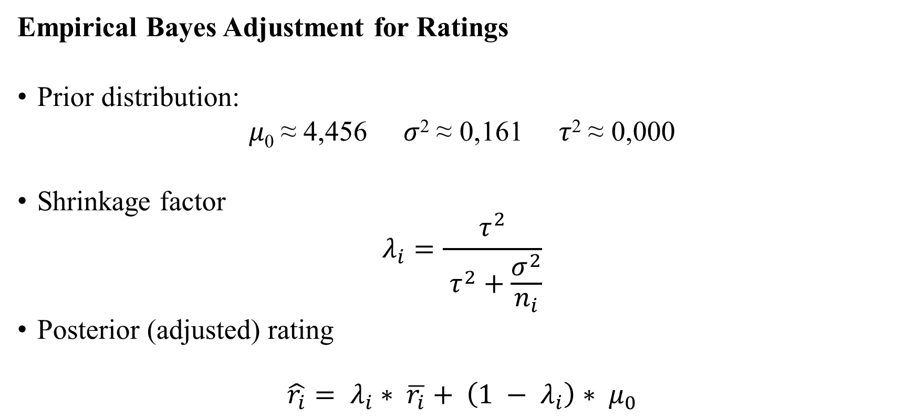
Global Index of Perceived Tourist Attractiveness
Empirical Bayes Adjustment for Ratings
Prior distribution:
𝜇₀ ≈ 4,456 𝜎² ≈ 0,161 𝜏² ≈ 0,000
Shrinkage factor
$$λ_{i}=\frac{τ^{2}}{ τ^{2}+\frac{σ^{2}}{n_{i}}}$$
Posterior (adjusted) rating
$$\hat{r_{i}}= λ_{i}∗ \overline{r_{i}}+ \left(1 − λ_{i}\right)∗ μ_{0}$$

Slide 32
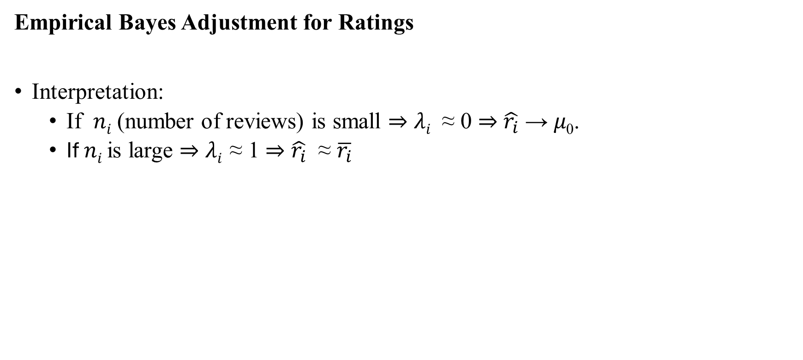
Global Index of Perceived Tourist Attractiveness
Empirical Bayes Adjustment for Ratings
Interpretation:
If 𝑛_{𝑖} (number of reviews) is small ⇒ 𝜆_{𝑖​} ≈ 0 ⇒ $\hat{r_{i}}$ → 𝜇₀.
If 𝑛_{𝑖}​ is large ⇒ 𝜆_{𝑖} ≈ 1 ⇒ $\hat{r_{i}}$ ≈ $\overline{r_{i}}$

Slide 33
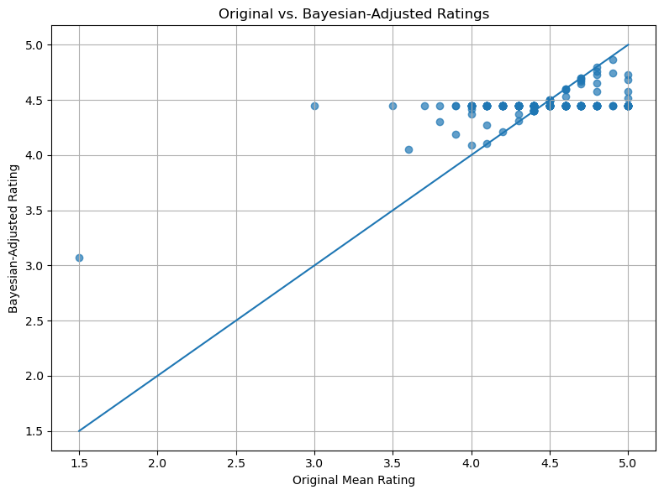
Global Index of Perceived Tourist Attractiveness
Empirical Bayes Adjustment for Ratings
The scatter-and-identity-line plot clearly illustrates the “shrinkage” effect of the Bayesian adjustment. Venues with unusually low original ratings tend to have their adjusted scores pulled upward toward the global mean, appearing above the diagonal line. Conversely, venues with very high original ratings see their adjusted scores pulled downward, falling below the identity line.Points closer to the diagonal correspond to venues with more stable and well-supported ratings, which are only minimally adjusted. Overall, the Empirical Bayes adjustment works to compress extreme values, stabilizing ratings and offering a more reliable and comparable measure of perceived attractiveness across venues.

Slide 34
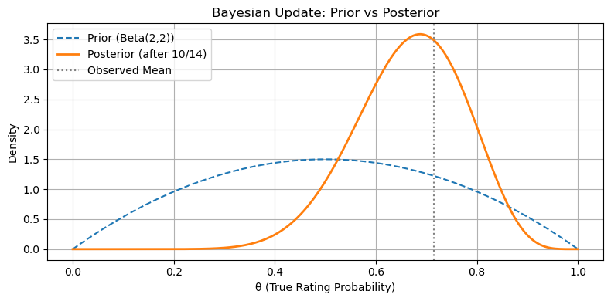
Global Index of Perceived Tourist Attractiveness
Empirical Bayes Adjustment for Ratings
Interpretation of the Bayesian Update Plot:
Prior Distribution (Beta(2,2))
Represents initial belief before seeing any data.
It is symmetric around 0.5, reflecting neutral expectations (neither optimistic nor pessimistic).
Equivalent to imagining 2 positive and 2 negative ratings (weak prior).
Observed Data
10 out of 14 reviews are positive → empirical mean ≈ 0.714.
This provides the evidence to update the prior.

Slide 35
Global Index of Perceived Tourist Attractiveness
Empirical Bayes Adjustment for Ratings
Interpretation of the Bayesian Update Plot:
Posterior Distribution (Beta(12,6))
Combines the prior with the observed data.
The curve shifts right toward the observed mean, but does not fully reach it.
Reflects increased confidence in higher true rating probability, while still incorporating uncertainty.
Vertical Line (Observed Mean)
Marks the empirical proportion of positive reviews.
The posterior centers close to this line, but is smoothed due to the prior.
Key Insight
Bayesian updating balances prior knowledge and new data.
It avoids overconfidence in small samples and stabilizes comparisons across locations with different numbers of reviews.

Slide 36
Global Index of Perceived Tourist Attractiveness
Average sub-indices:
(1) Rating_Bayes_Norm ≈ 0.81
(2) Popularity_Norm ≈ 0.0022
(3) Sentiment_Norm ≈ 0.6548
Global Index Range: [0.095, 0.873]

Slide 37
Global Index of Perceived Tourist Attractiveness
Top 5 locations by IGATP:
Rank | Location | IGATP
1 | Luís I Bridge | 0.873
2 | Jardim do Morro | 0.644
3 | Abadessa Restaurante e Petiscos | 0.635
4 | Parque Nascente Shopping | 0.622
5 | La Bocca Dolce | 0.613

Slide 38
Global Index of Perceived Tourist Attractiveness
Data was exported to composite_index.csv
Columns: 'Cidade', 'Categoria', 'Nome', 'Rating', 'Endereço', 'Tipos',
'Latitude', 'Longitude', 'Total_Reviews', 'id_unico', 'Grupo_Tematico',
'Locais_Semelhantes_Perto', 'Latitude_Nova', 'Longitude_Nova',
'Endereço_Limpo', 'shrinkage', 'Rating_Bayes', 'Nome_Local',
'Avg_Polarity', 'Rating_Bayes_norm', 'Popularity_norm',
'Sentiment_norm', 'IGATP'

Slide 39
Clustering Methodology
Why we applied clustering techniques:
To better understand the diversity of touristic locations in the Porto Metropolitan Area (AMP), we applied clustering techniques as an unsupervised learning approach to group places based on similarities in their perceived attractiveness profiles. By combining normalized sub-indices—Bayesian-adjusted rating, popularity, and sentiment polarity—we aimed to uncover latent patterns and classify locations into distinct segments. This segmentation enables a more interpretable analysis of the territory, identifying, for example, "boutique gems" or "mainstream attractions", and supports more targeted insights for stakeholders interested in tourism planning, territorial marketing, or resource allocation.

Slide 40
Clustering Methodology
Silhouette Analysis (K-Means)
Loaded the composite index dataset (composite_index.csv) containing the three normalized sub-indices: • (1) Rating_Bayes_norm • (2) Popularity_norm • (3) Sentiment_norm
Extracted these three columns into a feature matrix for clustering.
Applied mean imputation to replace any missing values with the column mean.
Standardized each feature to zero mean and unit variance (z-score normalization).
Performed K-Means clustering for k = 2…10 and computed the silhouette score for each k.
Plotted the silhouette scores versus k to identify the optimal number of clusters.

Slide 41
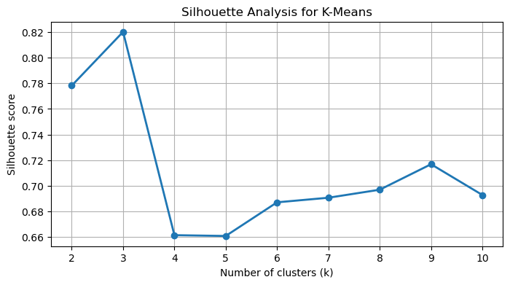
Clustering Methodology
Silhouette Analysis (K-Means)
The silhouette analysis reveals a clear peak at k = 3 (≈ 0.82), indicating strong cohesion and separation in a simplified segmentation. However, almost all observations fall into a single cluster, limiting interpretability.Beyond k = 3, scores decrease but stabilize, remaining in the 0.66–0.70 range. Among these, k = 6 offers a valuable compromise: it segments the data into multiple interpretable groups while maintaining a silhouette score close to the plateau.In practical terms, k = 6 is selected to balance segmentation richness and clustering quality.

Slide 42
Clustering Methodology
Imbalanced Cluster Sizes
At k = 6, K-Means yields a well-distributed segmentation:
One large cluster (n = 1983)
Three moderately sized clusters (n = 246, 145, 118)
One small but non-negligible group (n = 27)
One singleton (n = 1), likely an outlier
This configuration avoids the micro-cluster inflation observed at k = 8, while still enhancing granularity compared to k = 3.
With a silhouette score of 0.68, this structure offers improved interpretability without introducing excessive fragmentation.
Cluster Size Distribution at k=6:
Cluster | Count of Points
0 | 1983
4 | 246
3 | 145
5 | 118
2 | 27
1 | 1

Slide 43
Clustering Methodology
Imbalanced Cluster Sizes
We compared K-Means configurations for k = 3, 6, 7, and 8:
k = 3 yields strong silhouette but lacks segmentation (one cluster holds 97% of data).
k = 6 introduces three well-sized groups and a small meaningful segment, with minimal noise.
k = 7 and k = 8 bring micro-clusters (n = 1–2), suggesting over-fragmentation.
Decision: We proceed with k = 6, which balances structural insight, cluster size distribution, and silhouette stability. The singleton is treated as an outlier.
k | Cluster Sizes (descending)
3 | 2471, 48, 1
6 | 1983, 246, 145, 118, 27, 1
7 | 1983, 246, 145, 116, 27, 2, 1
8 | 1947, 243, 144, 140, 31, 12, 2, 1

Slide 44
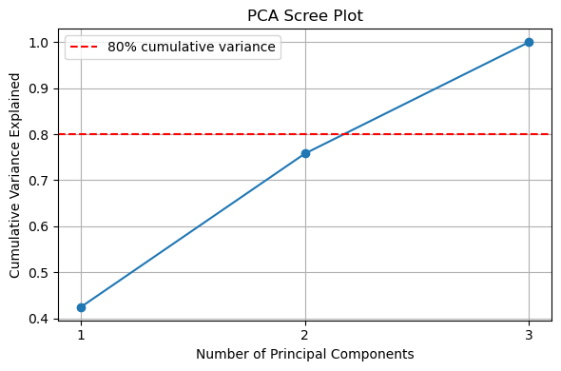
Clustering Methodology
PCA Visualization (K-Means): Choosing the Number of Principal Components
Cumulative Variance Criterion
PC1 explains 41.7 % of variance; PC1 + PC2 bring total to 75.0 %.
While 80 % is a common rule-of-thumb, 75 % already captures the majority of structure in our three-dimensional feature space.
Elbow Method & Parsimony
The scree curve shows a marked “elbow” after the second component, indicating diminishing returns from additional PCs.
Retaining only PC1 and PC2 balances model simplicity and information retention, avoiding overfitting or over-compression.

Slide 45
Clustering Methodology
PCA Visualization (K-Means): Choosing the Number of Principal Components
Interpretability & Visualization
Two components facilitate clear 2D visualizations (scatter plots, cluster overlays) for stakeholder communication.
Simplifies the interpretation of feature contributions (loadings) without substantial loss of explanatory power.
Practical Trade-Off
Using two components reduces computational complexity for downstream tasks (e.g. clustering, mapping) while preserving the core signal.
A third component could be added if > 80 % variance is strictly required; however, PC1–2 suffice for our exploratory and segmentation objectives.

Slide 46
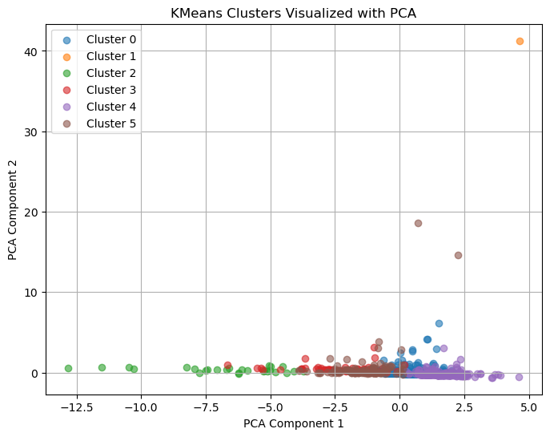
Clustering Methodology
PCA Visualization (K-Means)
Applied PCA to project scaled data into 2 dimensions (PC1, PC2)
Colored each point by its K-Means cluster label for visual inspection
Feature | PC1 Loading | PC2 Loading
Rating_Bayes_norm | 0.798 | 0.003
Popularity_norm | 0.081 | 0.995
Sentiment_norm | 0.794 | −0.105
PCA Interpretation:
PC1 (≈ 0.80 Rating + 0.79 Sentiment): captures combined “quality” and “emotional intensity”
PC2 (≈ 0.995 Popularity): isolates “visibility/popularity” dimension

Slide 47
Clustering Methodology
Clustering Results & Component Loadings (k=6)
Using the 6-cluster K-Means solution and the 2D PCA projection:
PC1 is interpreted as a proxy for quality/sentiment,
PC2 reflects popularity/visibility.
The PCA scatterplot reveals six distinguishable clusters:
Cluster 0 (Mainstream Core): The largest group, centered near the origin — reflects mid-tier, balanced locations.
Cluster 5 (Flagship Venues): High quality and visibility — prominent, top-rated points.
Cluster 4 (Boutique / Niche): High sentiment but low visibility — hidden gems or less-frequented highlights.
Cluster 2 (Underperformers): Low quality and low popularity — likely less attractive options.
Cluster 3 (Hidden Popular): Higher visibility despite below-average sentiment — potentially overrated or controversial spots.
Cluster 1 (Extreme Outlier): Isolated point with extreme values in both dimensions — possibly an anomaly or very unique venue.
Cluster | Size | PC1 | PC2 | Profile
0 | 1983 | ≈ 0 | ≈ 0 | Mainstream Core
5 | 118 | ↑ | ↑ | Flagship Venues
4 | 246 | ↑ | ↓ | Boutique / Niche
2 | 27 | ↓ | ↓ | Underperformers
3 | 145 | ↓ | ↑ | Hidden Popular
1 | 1 | ↑↑ | ↑↑ | Extreme Outlier

Slide 48
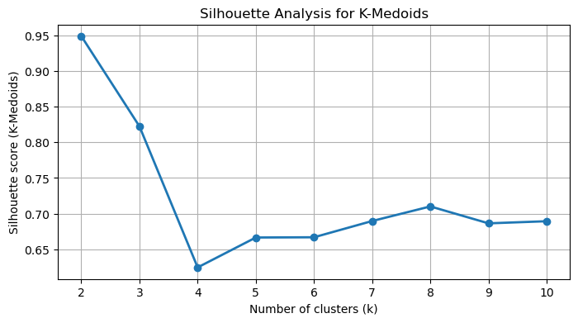
Clustering Methodology
Silhouette Analysis (K-Medoids)
Decision Rationale:
k = 2–3 shows high silhouette but overly broad segmentation.
k = 4 exhibits a sharp drop in silhouette, suggesting weak structure.
k = 5–8 yields stable silhouette scores (~0.66–0.71), with improved interpretability.
k = 6 offers a balance between cohesion and segmentation richness:
Clear structure without over-fragmentation.
Compatible with the K-Means solution for consistency.
→ We adopt k = 6 for our final K-Medoids clustering, as it:
Provides interpretable and balanced cluster sizes
Ensures robust cohesion and separation
Aligns with prior K-Means results to enable cross-method comparison

Slide 49
Clustering Methodology
Clustering Performance Comparison (K-Means vs K-Medoids)
Adjusted Rand Index (ARI)
ARI (KMeans vs KMedoids) for k=6: 0.861
⇒ Indicates very high agreement, with both algorithms recovering similar segmentations despite methodological differences.
Silhouette Scores
K-Means (k=6) 0.687
K-Medoids (k=7): 0.667
⇒ Both > 0.6 → strong cluster cohesion and separation
⇒ K-Means only marginally higher (+0.020)
Interpretation & Choice
Clusters are comparably well-defined (silhouette difference < 0.02).
K-Medoids preferred for practical interpretation:
Real-world exemplars: medoids correspond to actual POIs, enhancing interpretability.
Outlier resistance: more robust against extreme or noisy values.
➤ Despite the slight drop in silhouette, K-Medoids provides representative, actionable tourism clusters.

Slide 50
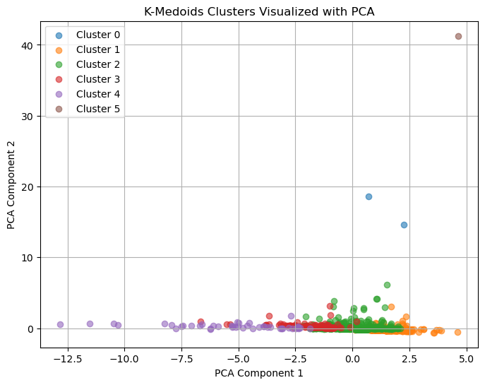
Clustering Methodology
PCA Visualization (K-Medoids)
Applied PCA to project scaled data into 2 dimensions (PC1, PC2)
Colored each point by its K-Medoids cluster label for visual inspection
Feature | PC1 Loading | PC2 Loading
Rating_Bayes_norm | 0.798 | 0.003
Popularity_norm | 0.081 | 0.995
Sentiment_norm | 0.794 | −0.105
PCA Interpretation:
PC1 (≈ 0.80 Rating + 0.79 Sentiment): captures combined “quality” and “emotional intensity”
PC2 (≈ 0.995 Popularity): isolates “visibility/popularity” dimension

Slide 51
Clustering Methodology
Clustering Results & Component Loadings (k=6)
Using the 6-cluster K-Medoids solution and the 2D PCA projection:
PC1 is interpreted as a proxy for quality/sentiment,
PC2 reflects popularity/visibility.
The PCA scatterplot reveals six distinguishable clusters:
Cluster 2 (Mainstream Core): The dominant segment (2070 points), positioned near the center — average locations with balanced sentiment and visibility.
Cluster 3 (Flagship Venues): Highly rated and popular locations (148 points), situated in the upper-right quadrant of the PCA space.
Cluster 1 (Hidden Popular): 254 points with low sentiment but higher popularity — possibly overrated or trending places.
Cluster 4 (Underperformers): Small cluster (45 points) with low quality and visibility — potentially weak or outdated attractions.
Cluster 0 (Boutique / Niche): Only 2 observations, high sentiment but limited exposure — hidden gems or specialized locations.
Cluster 5 (Extreme Outlier): A single observation with extreme values in both dimensions — likely an anomalous or unique spot.
Cluster | Size | PC1 | PC2 | Profile
2 | 2070 | ≈ 0 | ≈ 0 | Mainstream Core
3 | 148 | ↑ | ↑ | Flagship Venues
1 | 254 | ↓ | ↑ | Hidden Popular
4 | 45 | ↓ | ↓ | Underperformers
0 | 2 | ↑ | ↓ | Boutique / Niche
5 | 1 | ↑↑ | ↑↑ | Extreme Outlier

Slide 52
Clustering Methodology
Exporting Clustered Dataset
We exported the full composite index with all cluster assignments to a CSV file for reproducibility and downstream analysis.
File saved as composite_index_with_clusters.csv, containing:
Original POI attributes (ratings, sentiment, popularity, PCA scores, etc.)
K-Means labels for k=2,3,6, 7, 8 and 9 (cluster_k2, (…), cluster_k9)
K-Medoids labels for k=6 and k=7 (cluster_k6_pam, cluster_k7_pam)
This consolidated file ensures easy sharing and integration with mapping or spatial‐statistical tools.

Slide 53
Clustering Methodology
Data was exported to composite_index_with_clusters.csv
Columns: 'Cidade', 'Categoria', 'Nome', 'Rating', 'Endereço', 'Tipos',
'Latitude', 'Longitude', 'Total_Reviews', 'id_unico', 'Grupo_Tematico',
'Locais_Semelhantes_Perto', 'Latitude_Nova', 'Longitude_Nova',
'Endereço_Limpo', 'shrinkage', 'Rating_Bayes', 'Nome_Local',
'Avg_Polarity', 'Rating_Bayes_norm', 'Popularity_norm',
'Sentiment_norm', 'IGATP', 'cluster_k2', 'cluster_k3', 'cluster_k6',
'cluster_k7', 'cluster_k8', 'cluster_k9', 'cluster_k7_pam',
'cluster_k6_pam'

Slide 54
Topic Modeling
Why Perform Topic Modeling?
Uncover Latent Themes
– Automatically extract recurring topics from thousands of visitor comments
– Reveal what aspects (e.g. food, service, views) drive perceptions
Complement Quantitative Indices
– Go beyond star ratings and sentiment scores to understand why attractions are loved (or criticized)
– Link thematic insights to our Bayesian-adjusted ratings for richer interpretation• Inform Strategic
Actions
– Identify strengths (e.g. “wine tasting,” “scenic overlooks”) and pain points (e.g. “long waits,” “high prices”)
– Guide targeted improvements and marketing messages based on actual visitor language
Enhance Segmentation & Personalization
– Combine topic profiles with cluster membership to describe each tourist-attraction segment in human-readable terms
– Support tailored recommendations and experience design for different visitor interests

Slide 55
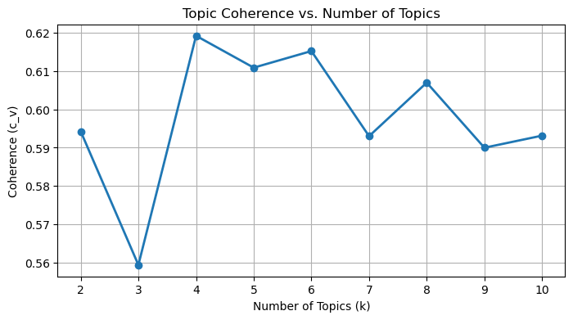
Topic Modeling
Choosing the Number of LDA Topics:
Interpretability & Parsimony:
k = 4 provides a semantic sweet spot:
Captures clear, coherent, and distinct themes.
Avoids fragmentation while ensuring each topic remains interpretable.
Easier to label and communicate to non-technical stakeholders.
Final Choice:
We select k = 4 topics for our LDA model — balancing high coherence (≈ 0.620) with clarity, conciseness, and actionability in topic interpretation.

Slide 56
Topic Modeling
Topic | Top 10 Terms
0 | stay, great, staff, place, recommend, friendly, good, clean, room, excellent
1 | food, good, service, restaurant, great, place, price, wine, delicious, recommend
2 | beach, place, nice, beautiful, walk, visit, museum, good, great, water
3 | room, hotel, clean, good, stay, breakfast, night, staff, bed, nice
Interpretation:
Topic 0 – Staff & Overall Experience
Emphasizes staff friendliness and overall satisfaction — terms like “stay”, “recommend”, “friendly”, “excellent”, and “clean” highlight positive general experiences with people and places.
Topic 1 – Gastronomy & Dining Quality
Focuses on food-related experiences — “food”, “restaurant”, “service”, “wine”, “delicious”, and “price” point to culinary satisfaction and value.
Topic 2 – Beach & Cultural Exploration
Combines coastal enjoyment and sightseeing — “beach”, “walk”, “museum”, “beautiful”, and “visit” suggest nature and culture-based tourism.
Topic 3 – Accommodation & Comfort
Highlights lodging quality — “room”, “hotel”, “clean”, “bed”, and “breakfast” focus on comfort, cleanliness, and sleep quality.
Stopwords (semantic):
good: a vague evaluative adjective frequently used across topics, offering little thematic differentiation.
great: similar to “good”; common in positive sentiment but lacks content-specific value.
nice: a generic descriptor often applied in multiple contexts without semantic depth.
recommend: a universal term of approval; signals satisfaction but does not specify the theme.
stay: semantically broad — can refer to lodging, duration, or general experience.
place: an ambiguous noun occurring in all contexts, offering no topic-level discrimination.

Slide 57
Topic Modeling
Topic | Top 10 Terms
0 | beautiful, beach, view, walk, amazing, porto, perfect, enjoy, area, thank
1 | room, hotel, clean, beach, breakfast, staff, night, bed, location, walk
2 | museum, visit, time, experience, worth, go, hour, interesting, history, small
3 | food, service, restaurant, friendly, staff, delicious, price, excellent, wine, amazing
Interpretation (after stop-word removal):
Topic 0 – Scenic Beauty & Leisure
Highlights visual and emotional appreciation of surroundings — “beautiful”, “view”, “walk”, “enjoy”, and “perfect” suggest a focus on aesthetic pleasure and relaxation.
Topic 1 – Accommodation & Location
Centers on lodging experiences — “room”, “hotel”, “clean”, “bed”, and “location” reflect comfort, hygiene, and proximity, with some overlap into coastal contexts.
Topic 2 – Cultural & MuseumVisits
Describes cultural exploration — “museum”, “visit”, “experience”, “interesting”, and “history” indicate educational and enriching activities.
Topic 3 – Dining & Hospitality
Focuses on the food experience — “food”, “restaurant”, “friendly”, “delicious”, “wine” and “service” reflect culinary satisfaction and host interactions.
Stopwords (semantic):
porto: a location-specific term that skews topic distribution; not representative of the broader metropolitan area under study.
thank: a generic expression of gratitude lacking thematic content.
area: vague spatial reference with low discriminative power across contexts.
location: a general-purpose noun appearing in multiple topics without thematic specificity.
time: a temporal word commonly used but rarely tied to a specific theme.
hour: similar to “time”; frequently used in visit descriptions but with low semantic contribution.
go: a high-frequency verb with little value in distinguishing topic themes.
amazing: a non-specific evaluative adjective that signals sentiment but lacks content.
perfect: emotionally charged but not thematically informative.
excellent: common in praise across topics but does not anchor specific content.

Slide 58
Topic Modeling
Topic | Top 10 Terms
0 | room, museum, hotel, bad, night, visit, like, work, small, house
1 | room, clean, hotel, breakfast, staff, walk, comfortable, quiet, helpful, city
2 | beach, walk, water, view, sand, visit, people, wave, long, sea
3 | food, service, restaurant, delicious, price, staff, wine, dish, quality, eat
Interpretation (after stop-word removal):
Topic 0 – Lodging & Cultural Impressions
Reflects a combination of accommodation-related experiences and museum or indoor visits — terms such as “room”, “museum”, “hotel”, “night”, and “house” suggest overnight stays and cultural exploration. Previously dominant vague or negative terms (e.g., “bad”, “work”) have been removed to clarify the theme.
Topic 1 – Accommodation & Guest Comfort
Captures positive lodging attributes — “clean”, “comfortable”, “quiet”, “city”, and “walk” reflect location accessibility and overall guest satisfaction. The removal of “helpful” improves topic cohesion.
Topic 2 – Coastal Leisure & Scenic Elements
Emphasizes outdoor, seaside enjoyment — terms like “beach”, “sand”, “wave”, “sea”, and “view” point to contact with nature and coastal walking.
Topic 3 – Gastronomy & Culinary Satisfaction
Dedicated to food quality and restaurant service — “food”, “restaurant”, “wine”, “dish”, and “service” convey a clear focus on dining experience.
Stopwords (semantic):
like: a filler verb used broadly in expressions of preference or similarity, lacking thematic relevance.
work: a vague term that may refer to functionality or employment, offering low topic specificity.
small: a generic size descriptor with little semantic contribution to topic differentiation.
bad: a subjective evaluation common across complaint narratives, lacking thematic precision.
people: an overly broad noun that appears across contexts without adding content clarity.
helpful: a sentiment-laden adjective with limited thematic value across diverse contexts.

Slide 59
Topic Modeling
Topic | Top 10 Terms
0 | beach, walk, visit, museum, water, view, sand, wave, parking, worth
1 | room, hotel, clean, breakfast, staff, comfortable, night, bed, pool, quiet
2 | food, service, restaurant, delicious, price, staff, wine, dish, quality, eat
3 | room, night, book, hotel, leave, pay, find, tell, ask, center
Interpretation (after stop-word removal):
Topic 0 – Coastal & Cultural Attractions
Captures seaside and museum-related experiences — terms such as “beach”, “walk”, “museum”, “water”, and “view” reflect outdoor leisure and cultural visits. “parking” and “worth” suggest practical aspects and perceived value.
Topic 1 – Accommodation & Guest Comfort
Focuses on positive lodging experiences — “room”, “clean”, “comfortable”, “bed”, and “quiet” indicate rest and hygiene, while “pool” and “breakfast” highlight amenities.
Topic 2 – Gastronomy & Culinary Experience
Centers on dining quality and satisfaction — “food”, “restaurant”, “delicious”, “dish”, and “wine” express pleasure, while “price” and “staff” address value and service.
Topic 3 – Booking & Service Frustrations
Describes issues related to reservations and customer service — “book”, “leave”, “pay”, “find”, “tell”, and “ask” suggest communication problems or dissatisfaction with booking procedures or stay.
Stopwords (semantic):
worth: a generic evaluative term (“worth it”) conveying subjective value but lacking thematic specificity.
leave: a broad verb that may refer to checkout, dissatisfaction, or abandonment, without clear topic anchoring.
tell: a vague communication verb with minimal semantic contribution in thematic modeling.
ask: a frequent action verb that reflects interaction but lacks discriminative power.
find: a common verb expressing discovery or confusion, semantically broad and unspecific.
center: an ambiguous spatial noun that may refer to location or urban context, but does not define a coherent topic.

Slide 60
Topic Modeling
Topic | Top 10 Terms
0 | room, hotel, clean, breakfast, staff, night, bed, comfortable, bathroom, walk
1 | food, service, restaurant, delicious, staff, price, wine, dish, eat, quality
2 | visit, museum, history, interesting, say, house, pay, tour, book, english
3 | beach, walk, water, view, sand, wave, parking, sea, lovely, clean
Interpretation (after stop-word removal):
Topic 0 – Lodging & Guest Comfort
Focused on accommodation quality and guest experience — terms like “room”, “clean”, “comfortable”, “bed”, and “bathroom” reflect attention to cleanliness and comfort, while “walk” and “night” suggest convenience and overnight stays.
Topic 1 – Culinary Experience
Captures gastronomic satisfaction and service — “food”, “restaurant”, “delicious”, and “dish” indicate enjoyment, while “price” and “service” point to value and interaction quality.
Topic 2 – Museum & Cultural Visits
Describes visits to museums and historical sites — “museum”, “history”, “house”, and “tour” evoke indoor cultural experiences. Verbs like “say”, “pay”, and “book” reflect logistical and interpretative aspects.
Topic 3 – Coastal Leisure
Reflects outdoor and seaside experiences — “beach”, “sand”, “sea”, and “wave” indicate contact with nature, while “walk”, “view”, and “parking” add practical and aesthetic dimensions.
Stopwords (semantic):
say: a vague communication verb frequently used in quoted opinions or indirect references, offering low thematic value.
lovely: a sentiment-driven adjective that signals positive emotion but lacks specific contextual meaning, reducing topic clarity.

Slide 61
Topic Modeling
Topic | Top 10 Terms
0 | beach, walk, water, view, sand, clean, restaurant, parking, sea, wave
1 | food, service, restaurant, delicious, price, staff, wine, dish, eat, quality
2 | room, hotel, clean, staff, breakfast, night, bed, bathroom, comfortable, shower
3 | visit, museum, house, love, space, welcome, feel, family, super, host
Interpretation (after stop-word removal):
Topic 0 – Seaside Leisure & Accessibility
Focused on coastal enjoyment and practical surroundings — “beach”, “sea”, “sand”, “wave” and “view” reflect natural features, while “walk”, “parking”, and “restaurant” suggest convenience and amenities near the coast.
Topic 1 – Culinary Satisfaction & Dining Quality
Highlights gastronomic experience — “food”, “restaurant”, “delicious”, and “wine” convey positive perception of meals, while “price”, “service”, and “staff” refer to practical service dimensions.
Topic 2 – Lodging Comfort & Facilities
Emphasizes hotel quality and comfort — “room”, “clean”, “bed”, “shower”, “bathroom” and “comfortable” indicate satisfaction with accommodation and hygiene.
Topic 3 – Personal Welcome & Emotional Connection
Distinctively captures emotional warmth and host interaction — “love”, “feel”, “welcome”, “family”, “super” and “host” suggest affective language tied to homestays or guest relations.
Stopwords (semantic):
super: an informal intensifier used in casual praise (e.g., “super nice”, “super host”), lacking thematic precision.
love: an emotion-laden verb expressing strong sentiment but offering no topic-specific content.
feel: a subjective verb related to personal impressions, weak in thematic discrimination.
welcome: a positive reception term that conveys friendliness but lacks contextual depth.

Slide 62
Topic Modeling
Topic | Top 10 Terms
0 | beach, walk, view, water, sand, parking, clean, restaurant, quiet, wave
1 | room, hotel, clean, breakfast, staff, night, bed, comfortable, bathroom, shower
2 | visit, museum, house, history, interesting, portuguese, space, tour, family, host
3 | food, service, restaurant, delicious, price, staff, wine, dish, eat, quality
Interpretation (after stop-word removal):
Topic 0 – Coastal & Outdoor Leisure
Focused on seaside and open-air experiences — “beach”, “sand”, “wave”, “view”, and “walk” highlight nature and landscape enjoyment, while “restaurant”, “quiet”, and “parking” reflect convenience and amenities.
Topic 1 – Accommodation & Guest Facilities
Centers on lodging and comfort — “room”, “clean”, “bed”, “shower”, and “comfortable” describe physical conditions, while “staff”, “breakfast”, and “night” capture service and overnight experience.
Topic 2 – Cultural & Historical Visits
Emphasizes museum-related and heritage tourism — “museum”, “history”, “tour”, “portuguese”, and “space” suggest educational or historical interest. “visit” and “host” may indicate structured experiences or guided interactions.
Topic 3 – Gastronomic Quality & Dining Service
Strongly reflects food-related satisfaction — “food”, “restaurant”, “delicious”, “wine”, and “dish” point to enjoyment, while “price”, “service”, and “staff” convey aspects of value and attention.
No additional stop-words jump out—this set suffices before moving on to the next analysis step.

Slide 63
Topic Modeling – Cross-tab with Clusters
Linking Comment Topics to POI Clusters
1. Infer Topic Distributions
Apply the final LDA model to every comment
Obtain a probability vector of length k for each document
2. Label Each Comment by Its Dominant
ThemeIdentify the single topic with the highest probability
Assign that topic as the comment’s “dominant topic”
3. Combine with POI Cluster Assignments
Bring in each point-of-interest’s k-medoids cluster label
Align comments to their originating POI and its cluster
4. Analyze Theme vs. Cluster Frequencies
Create a matrix counting how many comments of each dominant topic appear in each POI cluster
Reveals which thematic concerns (e.g., dining, beaches, history) are most prominent per cluster
Dominant Topic | Cluster 1 | Cluster 2 | Cluster 3 | Cluster 4
Topic 0 | 158 | 360 | 143 | 16
Topic 1 | 193 | 656 | 375 | 215
Topic 2 | 203 | 370 | 160 | 16
Topic 3 | 877 | 978 | 210 | 28
Outcome: This mapping uncovers the dominant visitor feedback themes within each POI segment, guiding targeted improvements and insights.
Although clusters 0 and 5 contain real places within the study area — with valid ratings and review counts — these locations do not include textual comments. As such, they were retained in the overall attractiveness index computation (via rating and popularity), but excluded from topic-based analyses, due to the absence of sentiment and thematic information.

Slide 64
Topic Modeling – Cross-tab with Clusters
Mainstream Core (Cluster 2)
Largest POI segment.
Covers balanced experiences between comfort (Topic 1) and gastronomy (Topic 3).
Represents mid-tier venues with steady service and average visibility.
Flagship Venues (Cluster 3)
Strongly dominated by food-related content (Topic 3).
Popular, top-rated locations praised for their dining quality and overall experience.Hidden Popular (Cluster 1)
Despite lower visibility, shows rich feedback in cultural visits (Topic 2) and comfort (Topic 1).
Possibly under-the-radar attractions or trending places with niche appeal.
Underperformers (Cluster 4)
Most comments highlight mediocre or weak experiences (especially comfort and service).
Low prominence in leisure or cultural themes.Boutique / Niche (Cluster 0)
Only 2 POIs, with no associated comments.• Retained for index calculation only — excluded from topic analysis.
Extreme Outlier (Cluster 5)
Single POI with no text reviews.
Excluded from thematic analysis due to missing sentiment and content data, but kept in the final index.
Dominant Topic | Hidden Popular (Cluster 1) | Mainstream Core (Cluster 2) | Flagship Venues (Cluster 3) | Underperformers (Cluster 4)
Topic 0 (Beach & Outdoor Leisure) | 143 | 360 | 158 | 16
Topic 1 (Accommodation & Comfort) | 375 | 656 | 193 | 215
Topic 2 (Cultural & Historical Visits) | 160 | 370 | 203 | 16
Topic 3 (Gastronomy & Dining) | 210 | 978 | 877 | 28

Slide 65
Topic Modeling
Exporting Topic Modeling Results
Export to CSV
We compiled each POI’s dominant topic alongside its rating and sentiment metrics.
Exported the combined data to ratings_polarity_lda_topics.csv for easy sharing and reproducibility
Columns: 'Cidade', 'Categoria', 'Nome_Local', 'Autor', 'Texto', 'Data', 'Rating',
'Idioma', 'Data_Convertida', 'translated_text', 'Texto_Normalizado',
'Texto_Lematizado', 'Polaridade', 'Polaridade_Média', 'Topic_0',
'Topic_1', 'Topic_2', 'Topic_3', 'dominant_topic',
'cluster_k6_pam'

Slide 66
Validation
Correlation Between Sentiment and Bayesian Rating (Sub-Indices)
Method: Pearson Correlation (cleaned data)
Result: r = 0.27, p-value = 0.000
Interpretation:
Weak but significant positive correlation.
Suggests partial overlap, but each metric captures distinct aspects of perceived attractiveness.
Implication:
Justifies keeping both sub-indices in the global index (IGATP).
Enhances multidimensionality and avoids redundancy.

Slide 67
Validation
Sensitivity Analysis: IGATP Weighting Scenarios
Objective:
To evaluate the stability of the IGATP when adjusting the relative weight of its three components:
Rating_Bayes_norm
Popularity_norm
Sentiment_norm
Tested Scenarios:
Scenario | Weights (Rating / Popularity / Sentiment)
Equal Weights | 1/3 – 1/3 – 1/3 (reference)
Rating-Heavy | 0.50 – 0.25 – 0.25
Popularity-Heavy | 0.25 – 0.50 – 0.25
Sentiment-Heavy | 0.25 – 0.25 – 0.50

Slide 68
Validation
Sensitivity Analysis: IGATP Weighting Scenarios
Results (Pearson correlation with the equal-weight IGATP):
Rating-Heavy: r = 0.968
Popularity-Heavy: r = 0.980
Sentiment-Heavy: r = 0.968
Conclusion: All alternative weighting scenarios show very high correlation (r > 0.96) with the original IGATP. This indicates that the index is highly robust and not sensitive to moderate changes in weight distribution.

Slide 69
Validation
IGATP Consistency by Review Count
Comparison:
We tested whether the IGATP values change significantly when calculated on two review-count-based subsets:
Locations with ≥ 10 reviews
Locations with < 10 reviews
Pearson correlations with full dataset:
≥ 10 reviews: r = 1.000, p < 0.001
< 10 reviews: r = 1.000, p < 0.001
Conclusion:
The IGATP index is fully consistent across subsets, confirming its internal reliability regardless of the number of reviews per location.

Slide 70
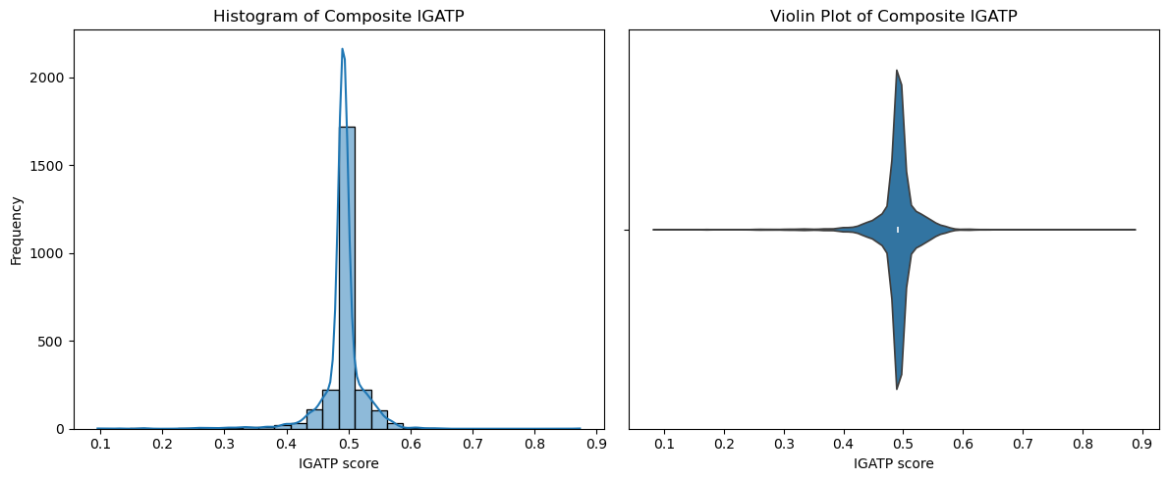
Validation
Distribution of Composite Index (IGATP)
Objective:
To examine the shape, central tendency, and dispersion of the IGATP scores.
Visualizations Used:
Histogram with KDE (left):
Shows a strongly peaked distribution, slightly right-skewed, with most values concentrated around 0.48–0.52.There are a few mild outliers above 0.6 and below 0.4, indicating limited tail behavior.
Violin Plot (right):
Reinforces the narrow concentration near the center and the low spread, confirming that the index is tightly centered with few extreme values.

Slide 71
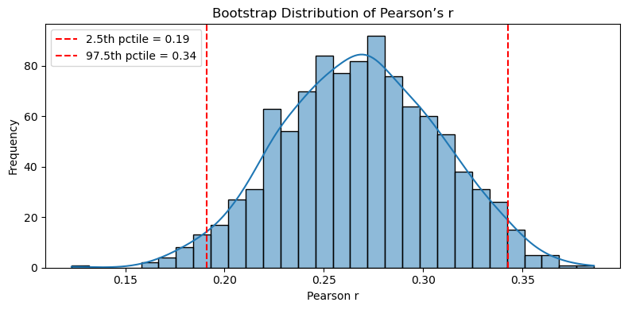
Validation
Bootstrap Confidence Interval for Pearson’s r
Objective: To quantify the uncertainty around the observed Pearson correlation between Rating_Bayes_norm and Sentiment_norm.
Methodology:
1,000 bootstrap resamples (with replacement)
Computed Pearson’s r in each resample
Extracted 2.5th and 97.5th percentiles as non-parametric CI
Results: Observed r: 0.2795% Bootstrap CI: [0.19, 0.34]
Conclusion: The correlation is statistically significant and robust,but remains moderate in strength.Confirms that the two sub-indices capture complementary dimensions of perceived attractiveness.

Slide 72
Validation
Validation of Clustering Structure
Objective:
To evaluate the quality of the clustering solution (k = 7, K-Medoids) based on the normalized sub-indices of the IGATP.
Methodology:
Used Silhouette Score on feature matrix: Rating_Bayes_norm, Popularity_norm, Sentiment_norm
Labels: cluster_k7_pam (K-Medoids, k = 7)
Result:
Silhouette Score = 0.667
Interpretation:
Score well above 0.6 → indicates strong cluster cohesion and separation.
Confirms the validity and interpretability of the 7-cluster K-Medoids structure.

Slide 73
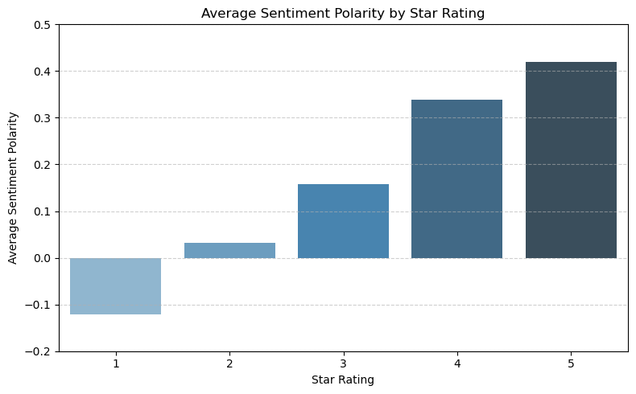
Validation
Objective:
To verify the alignment between NLP-based sentiment polarity and explicit user ratings (1★–5★).
Findings from the Plot:
1★ → clearly negative polarity (≈ -0.1)
2★ → near-neutral sentiment
3★ → moderate positivity
4★ → clearly positive
5★ → strongly positive (≈ +0.42)
Conclusion: The monotonic increase confirms that the sentiment polarity scale is consistent with user satisfaction.Validates sentiment polarity as a trustworthy component of the IGATP.

Slide 74
Spatial Analysis
Spatial Analysis of Points of Interest – Methodology
Objective:
To visualise the spatial distribution of the IGATP and its sub-indices (Rating_Bayes, Popularity, and Sentiment) within the Porto Metropolitan Area (AMP), using georeferenced points of interest.
Procedures:
Removal of observations without coordinates (Latitude_Nova, Longitude_Nova).
Conversion to a GeoDataFrame with point geometries (EPSG:4326).
Application of a spatial join with the AMP municipal polygons to retain only valid points.
Individual visualisation of each indicator based on value-driven colour mapping (cmap = "viridis") over municipal boundaries.

Slide 75
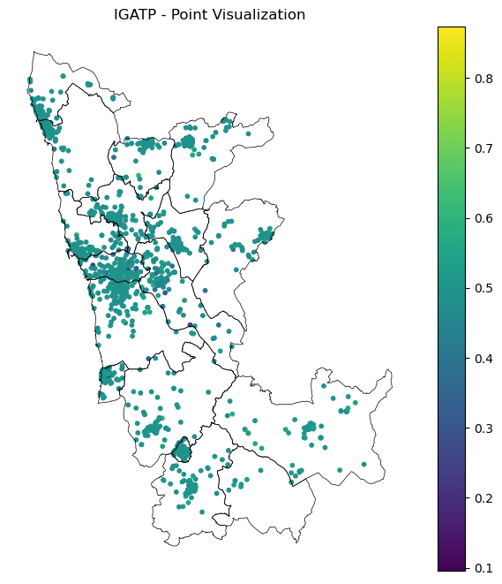
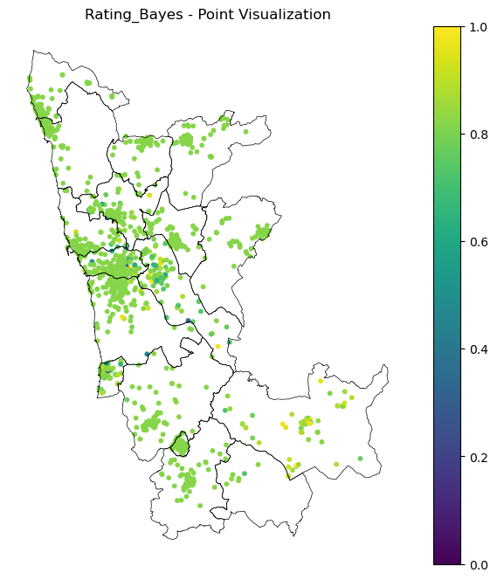
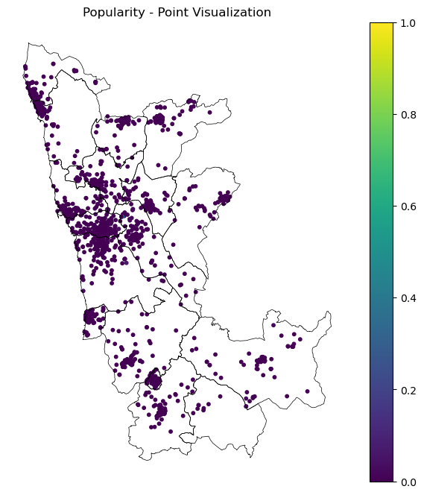
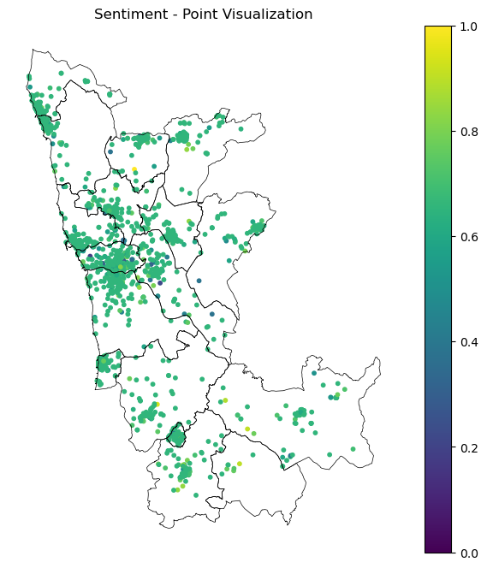
Spatial Analysis
Spatial Analysis of Points of Interest – Results
Limitations of Point-Based Visualization:
The high density of points in urban areas leads to visual overlap, making it difficult to perceive clear spatial patterns.Since many points are very close or nearly overlapping, point-based maps are not sufficiently informative to reveal significant territorial differences.

Slide 76
Spatial Analysis
Aggregated Spatial Analysis by Municipality – Methodology
Objective:
Evaluate the average distribution of the IGATP and its sub-indices (Rating_Bayes, Popularity, Sentiment) aggregated by municipality within the Porto Metropolitan Area (AMP).
Procedures:
Performed a spatial join between each point of interest and its corresponding municipality (DICO_right).
Calculated the mean score per municipality for each indicator.
Merged results with the municipal shapefile (gdf_mun) using a left join.
Created thematic maps with municipal-level averages, coloured using the viridis scale for visual contrast.

Slide 77
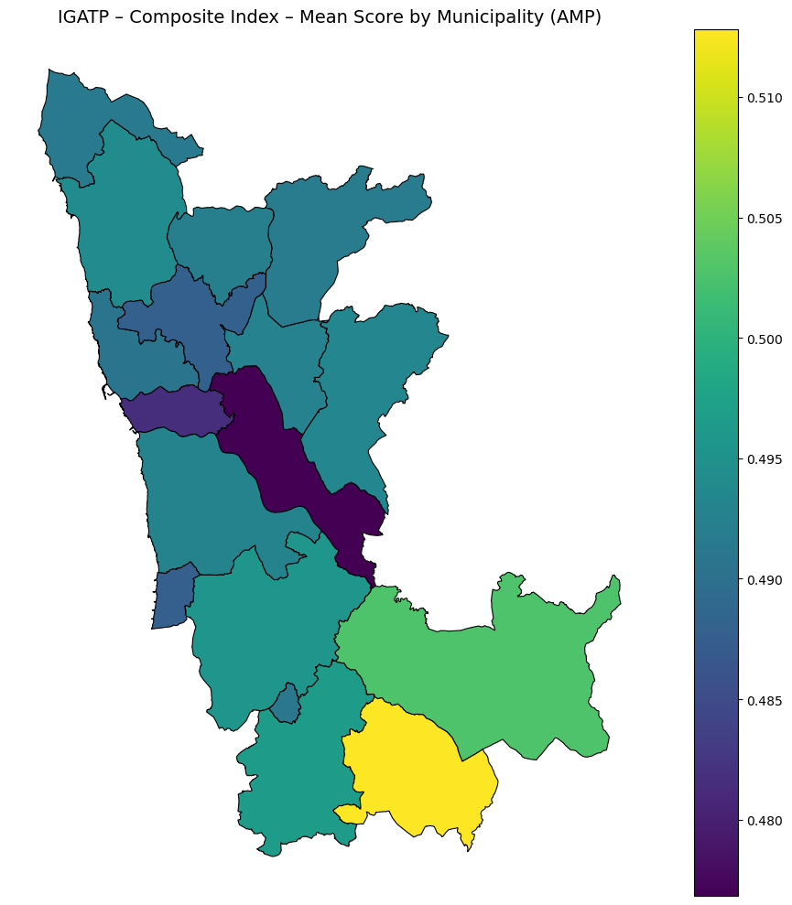
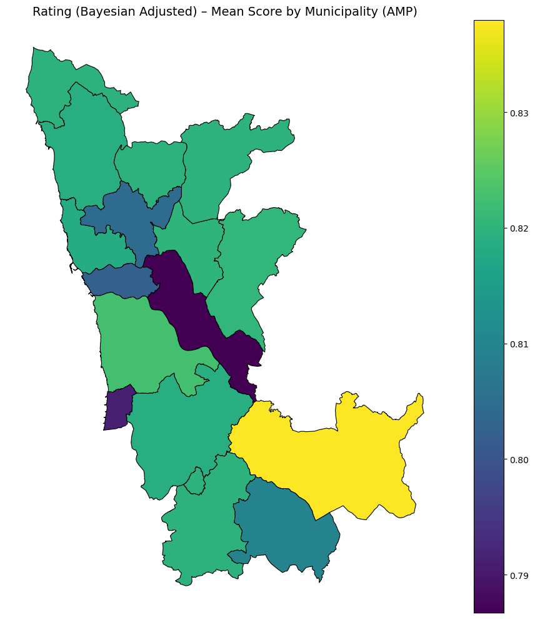
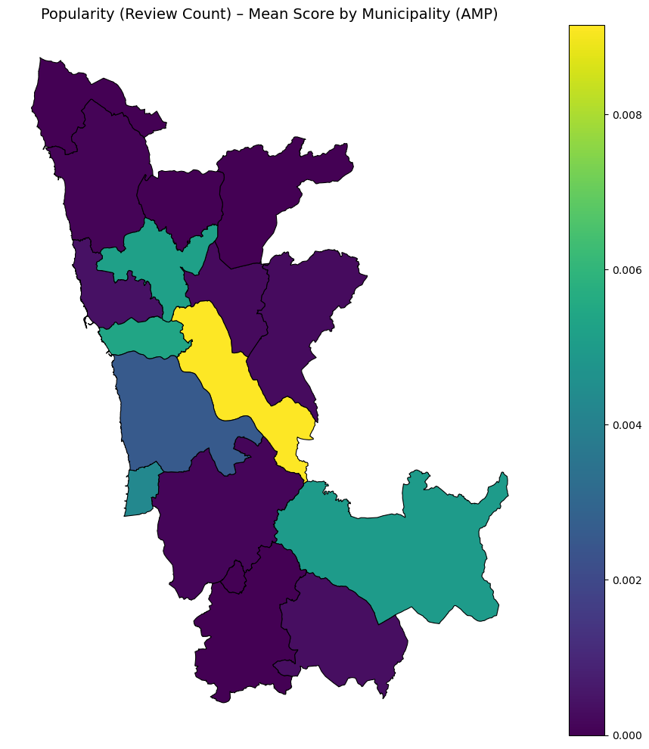
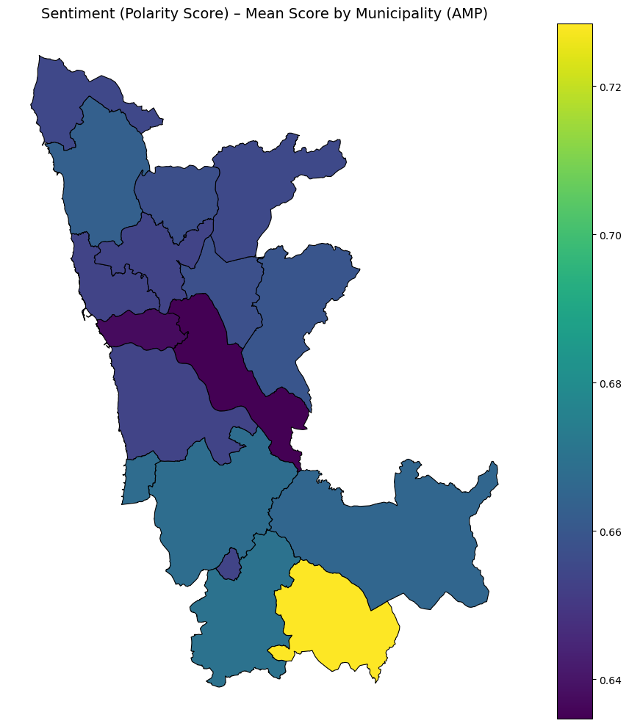
Spatial Analysis
Aggregated Spatial Analysis by Municipality – Results
IGATP – Composite Index:
Municipal averages show very little variation (≈0.48–0.51).
Suggests a regionally balanced level of perceived attractiveness, with minor peaks in Arouca and Vale de Cambra.
Rating (Bayesian Adjusted):
Also highly uniform across municipalities (≈0.79–0.83), reinforcing consistent user satisfaction.

Slide 78
Spatial Analysis
Aggregated Spatial Analysis by Municipality – Results
Popularity (Review Count):
Despite low absolute variation (≈0.000–0.009), the distribution is highly unequal:
A few central municipalities (e.g. Porto, Gaia) concentrate most reviews;
Many others show near-zero visibility.
The map accentuates this relative disparity due to colour scaling.
Sentiment (Average Polarity Score):
Slightly wider range than rating (≈0.64–0.72).
More positive sentiment observed in the southern and inland municipalities.
Conclusion:
While most indicators show limited absolute variation, the Popularity sub-index reveals substantial disparities in digital engagement.This municipal-level analysis provides a baseline for the upcoming finer-grained analysis at the parish level.

Slide 79
Spatial Analysis
Aggregated Spatial Analysis by Parish – Methodology
Objective:
To analyse the spatial distribution of the IGATP and its sub-indices (Rating_Bayes, Popularity, and Sentiment) at the parish level within the Porto Metropolitan Area (AMP), allowing for finer-grained detection of local patterns not visible at the municipal scale.
Procedures:
A spatial join was performed between the georeferenced points (gdf_points) and the parish polygons (gdf_freg) using the within predicate.
For each parish (DICOFRE_le), the mean value of each index was calculated.
These averages were then merged with the parish shapefile for spatial visualisation.
Thematic maps were generated using a continuous colour scale (viridis) to facilitate comparative interpretation across parishes.
Note: Some parishes do not contain any georeferenced points, resulting in missing values (NaNs) for one or more indices. These gaps reflect either low digital representation or absence of reviewed points of interest.

Slide 80
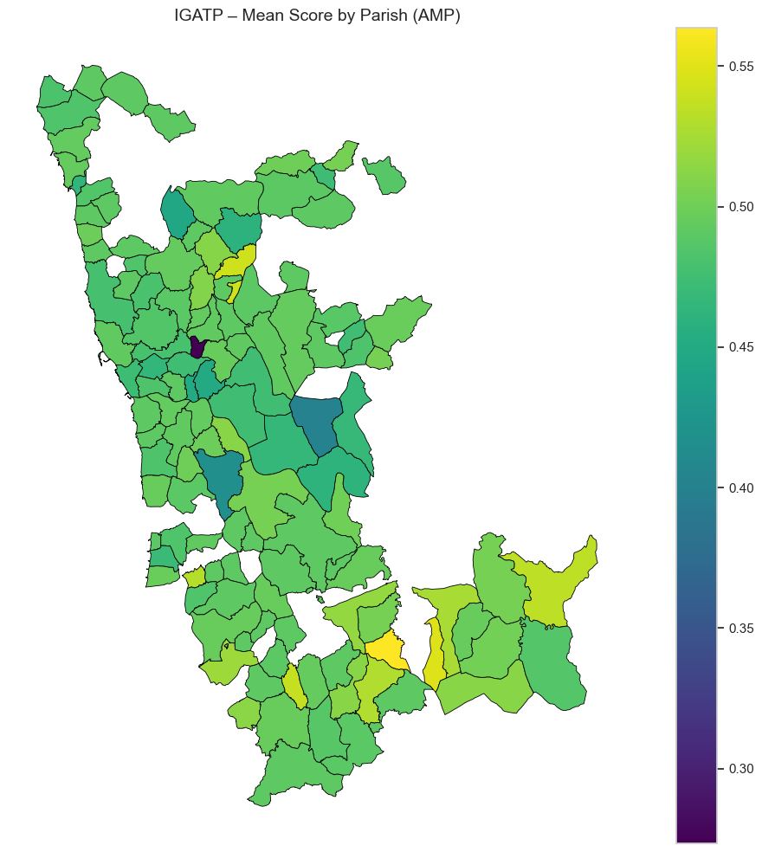
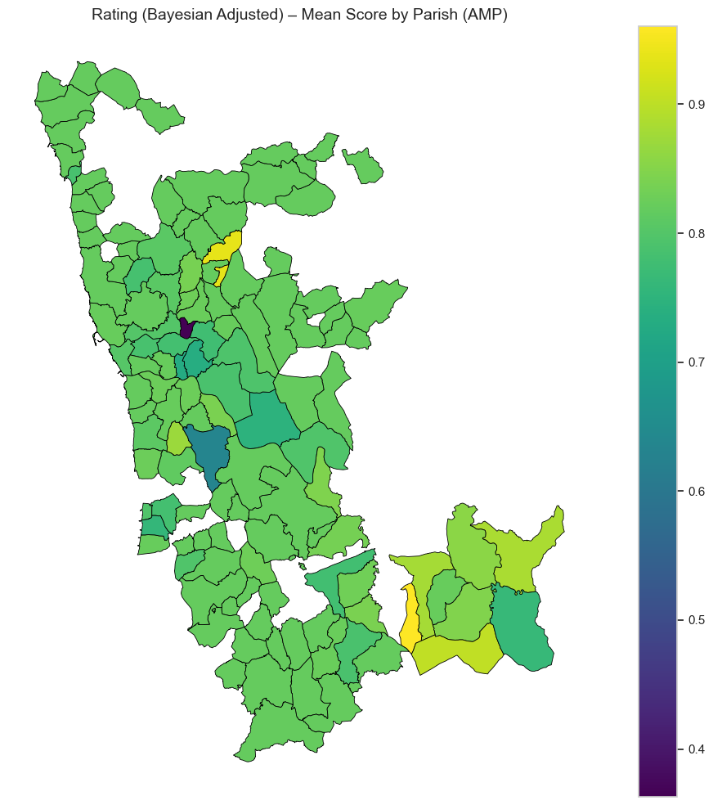
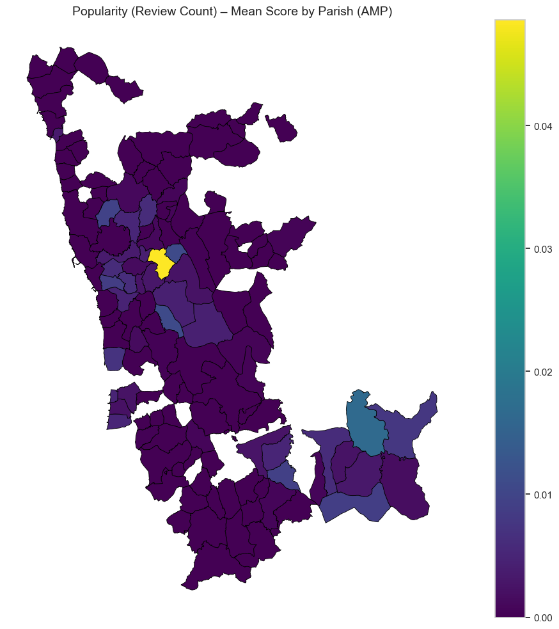
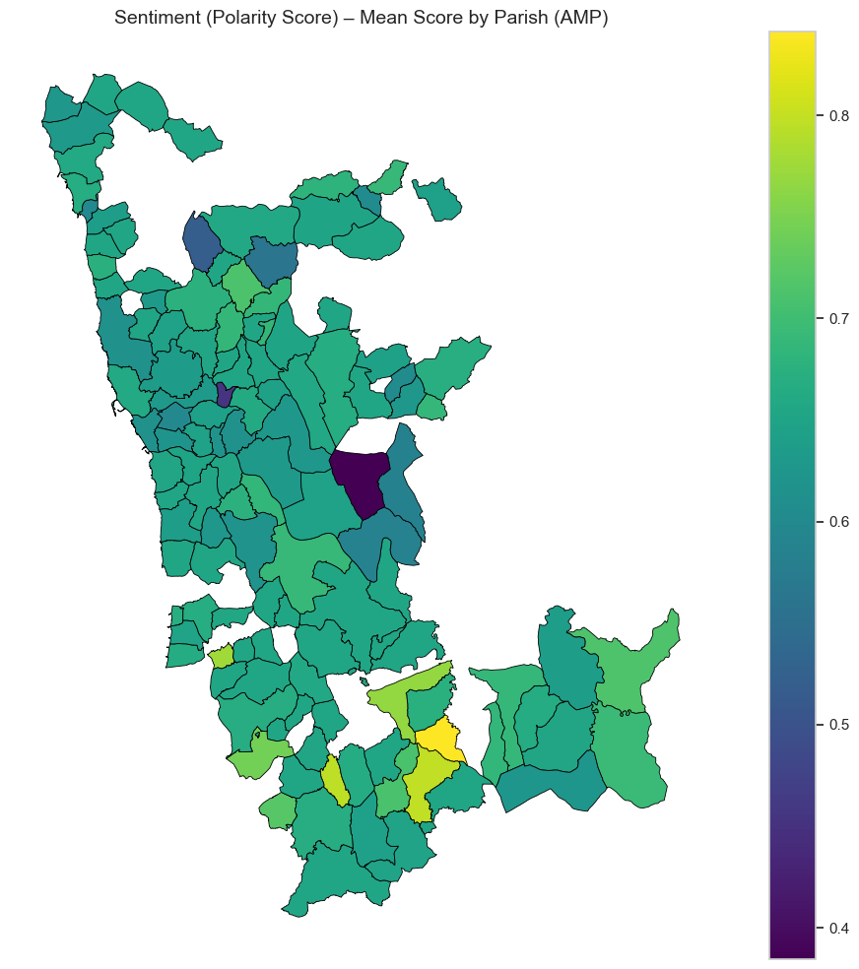
Spatial Analysis
Aggregated Spatial Analysis by Parich – Results
IGATP – Global Index:
Mean values range between ≈0.30 and 0.55.
Greater heterogeneity is observed compared to the municipal scale, with some inland parishes and those in southern Arouca standing out positively.
Rating (Bayesian Adjusted):
Generally positive distribution, with some more inland parishes showing average values above 0.90.
Two parishes exhibit atypically low values (below 0.60).

Slide 81
Spatial Analysis
Aggregated Spatial Analysis by Parich – Results
Popularity (Review Count):
Despite a narrow absolute range, the distribution is highly unequal:
A few parishes (notably in Porto and Vila Nova de Gaia) concentrate the majority of reviews.
Most parishes have near-zero values, reflecting very limited digital visibility.
Sentiment (Polarity Score):
Wider range (≈0.40 to 0.80), enabling the identification of more extreme perceptions.
Several southern parishes stand out for their positive emotional tone in reviews.
Conclusion:
Parish-level analysis allows for the detection of more detailed spatial patterns and highlights local inequalities in perceived attractiveness.The IGATP, when disaggregated, proves sensitive to intra-municipal diversity, which reinforces the relevance of using a finer-scale approach.

Slide 82
Spatial Analysis
Top Municipalities by Perceived Attractiveness (IGATP)
Interpretation:
The highest-ranked municipalities are mostly peripheral within the AMP.
The strong performance of Vale de Cambra and Arouca likely reflects a combination of good ratings and more positive perceived sentiment.
These results suggest that perceived attractiveness is not concentrated in major urban centers, but may instead emerge in less central territories.
Top 5 Municipalities – Mean Global Attractiveness Index (IGATP):
Municipality | Global Index Mean
Vale de Cambra | 0.513
Arouca | 0.503
Oliveira de Azeméis | 0.497
Santa Maria da Feira | 0.496
Vila do Conde | 0.494

Slide 83
Spatial Analysis
Bottom Municipalities by Perceived Attractiveness
Interpretation:
Larger and denser municipalities like Porto, Gondomar, and Matosinhos appear among the lowest-ranked.
Despite hosting many points of interest, these areas may be affected by overexposure, lower sentiment, or greater rating variability.
The difference between top and bottom performers is modest (≈0.04), reinforcing the overall consistency of the index at the municipal level.
Bottom 5 Municipalities – Mean IGATP:
Municipality | Global Index Mean
Matosinhos | 0.491
Maia | 0.488
Espinho | 0.488
Porto | 0.482
Gondomar | 0.477

Slide 84
Spatial Analysis
Top 5 Parishes – Mean IGATP:
Parish | Global Index Mean
Chave | 0.564
Urrô | 0.549
Folgosa | 0.542
São Roque | 0.538
Alvarenga | 0.535
Parish-Level Ranking: Local Disparities
Interpretation:
Lower-scoring parishes include dense urban areas such as Bonfim (Porto) and suburban zones like Pedrouços (Maia).
Pedrouços, with the lowest index (0.273), represents an extreme case, possibly associated with a small number of reviews, poor sentiment, or low digital presence.
The intra-municipal disparities observed at the parish level highlight the importance of spatially disaggregated analysis, where more granular patterns of perceived attractiveness emerge.
Bottom 5 Parishes:
Parish | Global Index Mean
Bonfim | 0.450
União das Freguesias de Alvarelhos e Guidões | 0.446
União das Freguesias de Pedroso e Seixezelo | 0.418
Aguiar de Sousa | 0.401
Pedrouços | 0.273

Slide 85
Spatial Analysis
Global Spatial Autocorrelation – Moran’s I (Methodology)
Objective:
To evaluate the presence of global spatial autocorrelation patterns in the IGATP (Global Perceived Attractiveness Index), at both the parish and municipality levels.
Steps Performed:
Data Cleaning:
Observations with missing IGATP_mean values were removed.
Spatial Weights Matrix:
A Queen contiguity matrix was created (Queen.from_dataframe()), considering neighboring units that share either borders or vertices.
Moran’s I Calculation:
The global Moran’s I coefficient and significance (p-value) were computed using the Moran() function from the esda module, based on random permutations.
Variable Standardization:
IGATP values were standardized (z-scores) to allow scatterplot representation.
Visualization:
A Moran Scatterplot was built to visualize the relationship between standardized IGATP values and their spatial lag (average value among neighbors).
A red regression line indicates the strength and direction of the spatial autocorrelation.

Slide 86
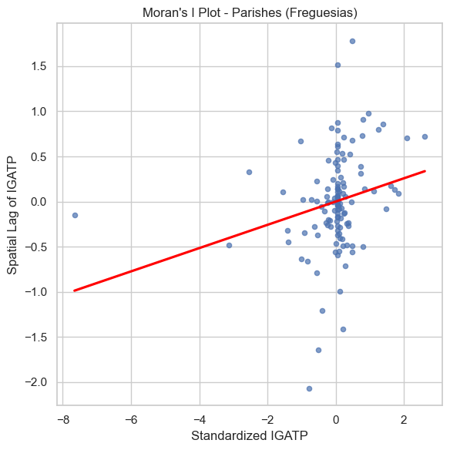
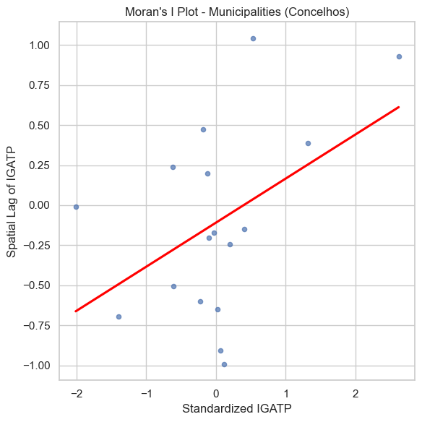
Spatial Analysis
Spatial Autocorrelation Analysis – Moran’s I
Interpretation:
The results confirm the presence of a spatial structure in the IGATP:
At the parish level, the spatial dependence is weaker, yet still statistically significant;
At the municipal level, the pattern is clearer and more pronounced.
This suggests that neighboring territories tend to share similar levels of perceived attractiveness, validating the use of spatial approaches in this type of analysis.
The upward trend in both Moran’s scatterplots (red line) visually confirms the presence of positive spatial dependence.
Spatial Autocorrelation Results:
Level | Moran’s I | p-value | Interpretation
Parishes | 0.1301 | 0.0200 | Weak but statistically significant positive spatial autocorrelation
Municipalities | 0.2751 | 0.0110 | Moderate positive spatial autocorrelation, also significant

Slide 87
Spatial Analysis
Spatial Cluster Mapping – LISA Methodology
Objective:
To identify significant local clusters of perceived attractiveness (IGATP) using Local Indicators of Spatial Association – Local Moran (LISA).
Procedures:
A Queen contiguity spatial weights matrix was created;
The Local Moran's I was applied to the average IGATP at the parish and municipality levels;
Statistical significance was assessed using 999 random permutations (α = 0.05);
Spatial units were classified into five categories:
Category | Description
High-High | High value surrounded by high values (positive cluster)
Low-Low | Low value surrounded by low values (negative cluster)
High-Low | High value surrounded by low values (positive spatial outlier)
Low-High | Low value surrounded by high values (negative spatial outlier)
Not Significant | No statistically significant spatial autocorrelation

Slide 88
Spatial Analysis
LISA Results – Interpretation of Clusters
Parishes:
High-High clusters are concentrated in the southern part of the AMP, indicating areas with consistently high attractiveness;
Low-Low clusters are found in more peripheral zones and some urban centers;
The presence of High-Low and Low-High configurations reveals spatial outliers, where attractiveness levels contrast with surrounding areas;
Most parishes show no significant spatial autocorrelation, reinforcing the intra-municipal heterogeneity of the index.
Municipalities:
High-High: detected in southern AMP, highlighting regions with spatially contiguous positive attractiveness;
High-Low: municipalities like Vila Nova de Gaia, where high IGATP values contrast with neighboring low values — suggesting local spatial polarization;
Low-High: municipalities with lower attractiveness surrounded by higher-scoring areas — indicating potential targets for policy intervention (Porto, Maia);
The presence of clear spatial patterns suggests that territorial promotion strategies should take into account regional dynamics rather than isolated contexts.
⚠️ Note: Some identified clusters, particularly in peripheral areas, may be partially influenced by limited data availability, especially due to the scarcity of user-generated reviews or content in those regions. Interpretation should therefore account for potential sampling bias.

Slide 89

Visualization
Purpose and Technologies Used
What is IGATP?
We developed an interactive dashboard to compute and visualize the IGATP – Global Index of Perceived Touristic Attractiveness in the Porto Metropolitan Area (AMP).
The index combines three dimensions from Google Maps:
Bayesian Rating
Popularity (number of reviews)
Sentiment (review polarity)
Technologies used:
Python (pandas, geopandas, scikit-learn, Altair)
LDA Topic Modeling and PCA + K-Medoids clustering
Kepler.gl and Streamlit for geospatial visualization and interactive interface

Slide 90

Visualization
Point Map – Locations with IGATP
Displays all georeferenced touristic locations in the AMP.
Points can be filtered by thematic group and tourist profile (cluster).
Users can click the left-side arrow on the map to activate pop-ups showing:
Name, category, city, IGATP score
Number of similar nearby locations
Dominant topic for each place
Filters and index weights are fully adjustable in the sidebar.

Slide 91

Visualization
Average IGATP by Municipality
Heatmap by municipality, showing the average IGATP based on the locations within each municipality.
Users can activate the layer in Kepler and customize the color gradient (e.g., quantile, sequential).
Helps identify municipalities with higher or lower perceived attractiveness.

Slide 92

Visualization
Average IGATP by Parish
More detailed view of the index at the parish level.
Based on a pre-processed dataset with average IGATP values per parish.
Ideal for assessing the local variation in perceived attractiveness, relevant for local planning and public policy.

Slide 93

Visualization
Touristic Attractiveness Rankings
Displays the Top 5 locations for each sub-index and for the overall IGATP.
Also includes:
Municipalities with highest and lowest average IGATP
Parishes with highest and lowest average IGATP
Provides a quick overview of highlights and low-performing areas in the region.

Slide 94

Visualization
Sentiment Trend Over Time
Line chart showing the monthly evolution of average review sentiment.
Helps identify:
Whether user perception is improving or worsening
Seasonal trends or event-related variations
Serves as a starting point for longitudinal analysis or strategic planning.

